Slide 1
Idling Reduction for Medium-Duty Fleets
Green Fleets Conference
Schaumberg, IL
October 2-3, 2012
Linda Gaines
Center for Transportation Research
Argonne National Laboratory

Slide 2
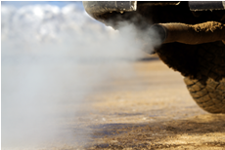
Basics: What Exactly Is Idling?
Idling is running a vehicle engine while the vehicle isn’t moving. Vehicle operators idle for a number of reasons—some better than others.
Notes:
First, let’s define idling. For our purposes, idling is running a vehicle engine for nonpropulsion purposes. Nearly all vehicle types can idle, and they do so for many reasons and for varying periods of time. The vehicle operator is usually in charge of whether to idle the vehicle.
When we think about the waste and emissions associated with idling, we often think about heavy-duty trucks and passenger cars. However, other vehicles such as buses, work trucks, ambulances, locomotives, ships, aircraft, and even construction and agricultural equipment idle for various reasons. The focus of this presentation is on-road vehicles.
While unnecessary idling should be avoided with any kind of vehicle, regardless of the fuel type used, this presentation focuses on vehicles that are petroleum-powered.
While the definition of idling as “Running a vehicle’s engine while the vehicle is stationary and not doing work” is generally good, it suggests that a good solution is to just turn the key. While that’s sometimes true, it’s more complicated than that. With the current state of technology, some types of engine idling are easier to remedy than others. I’ll talk about these issues a little later in the presentation.
Educating drivers, fleet managers, and other decision-makers about the consequences of unnecessary idling—and ways to reduce it—is one of Clean Cities’ goals.

Slide 3
Basics: Petroleum Use and Emissions
In the U.S., idling consumes about 6 billion gallons of oil, costing about $20 billion!
For rest-period truck idling alone, emissions total more than 130 tons of particulate matter (PM), 12 million tons of CO_{2,} 35,000 tons of NOx, and 36,000 tons of CO.
Half of idling fuel losses are estimated to be from everyday (noncommercial) drivers.
Notes:
According to researchers at Argonne National Laboratory, idling consumes about 4% of U.S. oil imports and about 8% of truck fuel.
About 700,000 long-haul trucks operate on U.S. roads. Very conservatively, the annual emissions from rest-period truck idling alone result in the formation of:
130 tons of particulate matter, also called “PM”
12 million tons of CO₂
35,000 tons of nitrogen oxides, also called “NOx”
36,000 tons of CO
Data assumptions: each truck idles 1,840 hours per year and all trucks are model year 2010 or newer (which run much cleaner than older trucks). Actual NOx values are likely to be quite a bit higher.
About half of idling losses can be attributed to long-haul truck rest period idling and commercial vehicles waiting in queue at depots, terminals, work sites, and border crossings during the workday. However, the other half of idling losses is estimated to result from millions of individual drivers waiting “just a few minutes” for their kids to get out of school, waiting for their friend to buy a soda at a convenience store, or waiting to move forward in line at a drive-through. It’s not much per car, but with 250 million cars on the roads in the U.S., these losses add up.

Slide 4
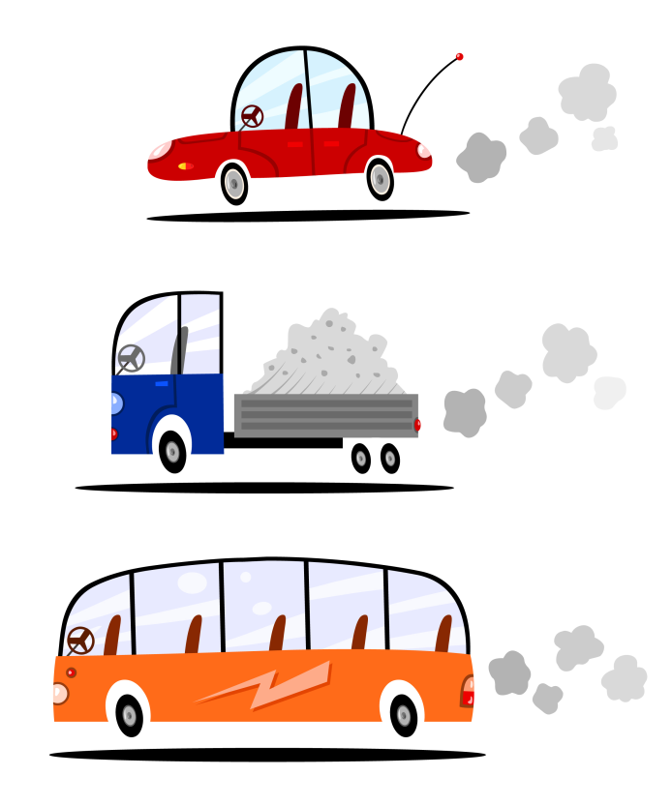
Basics: What Kinds of Vehicles Idle?
Light duty
Passenger vehicles, including taxis, police cruisers, and some light trucks
Medium duty
Utility vehicles, delivery trucks, shuttle buses, ambulances
Heavy duty
Long-haul trucks, tour buses, school buses
All vehicle types may idle,
but not necessarily for the same reasons.
4
Notes:
Basically, any vehicle can idle. A very general way to classify vehicles is according to their weight category: heavy duty, medium duty, or light duty. The ways states, or even federal agencies, define these vehicle categories vary—sometimes widely—but those differences aren’t important in this overview of the subject.
Light-duty vehicles are primarily passenger cars and trucks, SUVs, and pickup trucks. Light-duty work vehicles include taxis, police cruisers, and small delivery vehicles.
The most variable of the categories is the medium-duty vehicle. This group includes vehicles from city delivery trucks to snow plows, from shuttle buses to food truck “restaurants.” An important part of this group is utility trucks that “work in place.” Many of these vehicles are unique in that their primary purpose is to perform stationary work.
A work truck is basically a powerful tool attached to a vehicle and powered by its engine.
Heavy-duty trucks include long-haul trucks, city transit buses, motor coaches, school buses, fire trucks, refuse trucks, and some refrigeration trucks.
All vehicle types may idle.

Slide 5
Basics: Why Do Drivers Idle?
Habit
Power
For onboard auxiliaries (e.g., lights, computers)
For work trucks (power take-off, or PTO)
For moving in creep mode
Notes:
People idle their vehicles for reasons that fall into two general categories: Habit and the need to power devices.
The idling habit can be tackled with training and education, perhaps with the support of technology such as idle limiters and fleet telematics options that monitor and provide feedback on driver behavior.
“Idling for power” does not have a one-size-fits-all solution. The best solution will depend on the particular power needs.
Long-haul trucks may idle to provide heating or cooling for drivers during overnight rest periods. Police cars may idle not only to power warning lights and communications equipment, but to be “at the ready.”
Knowing the “why” of idling is important for evaluating potential solutions. Optimal solutions for delivery trucks will likely be different from those for work trucks.

Slide 6
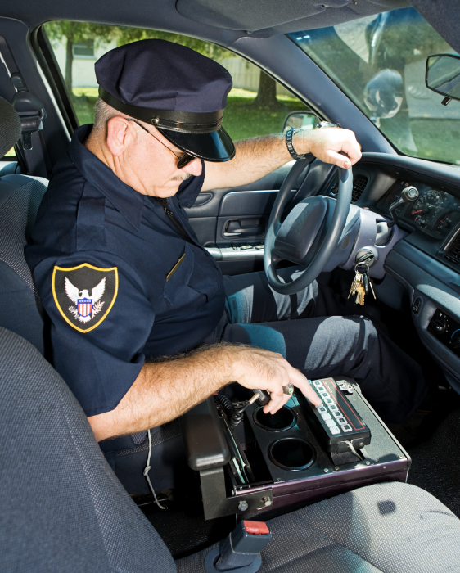
Basics: Idling for Power
Power for Auxiliaries
For driver and passenger safety and comfort
To provide power for warning lights and communications equipment
To maintain proper temperature for sensitive equipment and goods
Notes:
So, what are some of the other reasons vehicles idle? Some engines are left running for nonpropulsion purposes.
Let’s start with long-duration idling—the heavy-duty, long-haul truck. Long-haul trucks are in a special class, because the drivers often “hotel” in their cabs during their federally mandated rest periods. If these trucks aren’t equipped with idling reduction equipment, the drivers may need to run their engines to power HVAC, lights, microwave, and electronics. Currently, most long-haul trucks are not equipped with idling reduction equipment.
The issues of comfort and safety are not limited to long-haul truck drivers. Think about service providers who process paperwork in their vehicles between service calls; they use their vehicles as mobile offices. Or the snow plow operator waiting in his vehicle for his next assignment. Of course, passenger-transport vehicles, such as buses, often idle for driver and passenger comfort.
A number of work vehicles—such as utility trucks, fire trucks, and ambulances—are required to run warning lights. These and other work vehicles also often need to run communications equipment, which requires power. Police cruisers are a good example of this type of power need.
Finally, some vehicles must maintain particular temperatures for sensitive equipment and goods. Examples include ambulances, which contain medicines and medical equipment, and refrigeration trucks that carry meat or produce.
In very cold weather, some operators of diesel-fueled vehicles keep the engine running to keep the engine warm and the fuel from “gelling.” With newer engine technology and fuel blends and additives, this is increasingly less necessary.

Slide 7
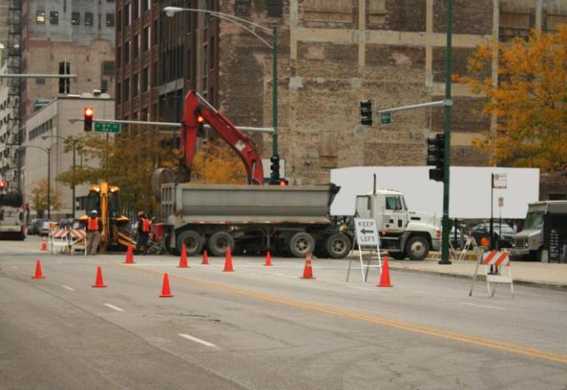
Basics: Idling for Power, cont.
Power Take-Off (PTO)
Power take-off refers to a device that diverts power from a vehicle engine to power another device (e.g., hydraulic lift on a bucket truck).
PTO powers nonpropulsion functions on work trucks.
Notes:
Finally, we have the category of power take-off, or PTO. PTO-equipped vehicles have a device attached to the engine’s transmission that transfers energy to another device. PTO trucks are usually work trucks, such as diggers and bucket trucks. In many cases, the vehicle remains stationary—possibly for hours at a time—while it performs work.
A PTO truck can be thought of as a powerful tool attached to a vehicle.
A few years ago, we might not even have mentioned power take-off, or PTO, in a discussion of idling reduction. We’re just starting to see technology that will allow the PTO equipment to be run from auxiliary power sources that are less expensive and “greener” than the vehicle’s engine. This is one of the most rapidly advancing areas in idle reduction technology.
PTO power aside, there are issues of operator comfort in PTO vehicles. Even if PTO equipment is not running, the vehicle operator may need climate control. Technologies are available to provide cab comfort, or power for auxiliaries, without the need to run the main engine.

Slide 8
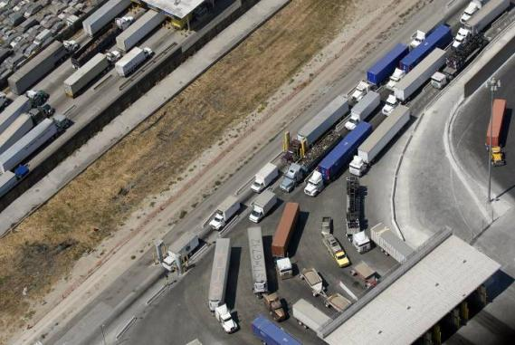
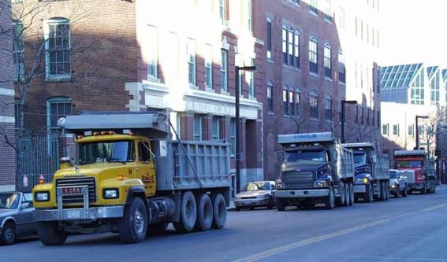
Basics: Idling for Power, cont.
Other Workday Idling
“Creeping” in queue
Waiting to load or unload goods or passengers, including:
Delivery trucks
Transit buses and motor coaches
Shuttle buses
Taxis
Notes:
Workday idling is distinct from overnight or rest-period idling. Workday idling includes delivery trucks waiting in queue at pickup or delivery destinations. Heavy-duty motor coaches or city buses may be found engaged in workday idling at pick-up and drop-off areas. For work trucks, engines may be left running to keep the cabin a comfortable temperature for operators returning to it after working, for example, on a utility pole.
Creeping in queue can occur in any congested area. Creep mode occurs not only at delivery and work sites, but at ports and border crossings.
“Creeping” aside, many vehicles idle when goods or passengers are being loaded or unloaded. Power may or may not be necessary during these idling episodes.
Argonne National Laboratory researchers state that workday idling may consume more fuel than overnight truck idling. Workday idling is a good target for reducing fuel use and emissions.

Slide 9
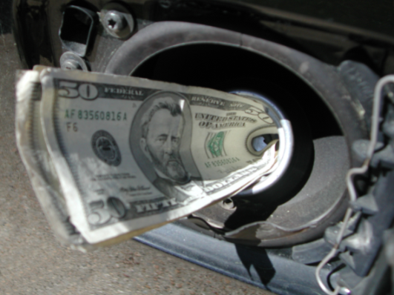
Basics: What’s Wrong with Idling?
The cost of fuel (for which the vehicle owner gets 0 mpg)
Idling wastes about 6 billion gallons of fuel per year; about half of that is from trucks idling overnight and during the workday
Increased petroleum consumption and reliance on nonrenewable resources
Engine wear
Increased maintenance costs
Notes:
Now we know why vehicles idle. Let’s talk about the consequences of idling.
First, idling consumes fuel, and fuel’s expensive. The fuel consumed is 0-mpg fuel. It’s hard to get worse than that if a vehicle’s main purpose is to move people or goods from one place to another. Obviously, time spent idling is going to pull down overall fuel economy. So, there’s the cost of that 0-mpg fuel.
Fleets that have adopted idling reduction measures have been able to put a good dent in fuel consumption. For example, Coca-Cola Bottling Company of Northern New England found, in 2004, that trucks averaged a 15% idling time. It implemented a simple idle reduction strategy (a “turn it off” policy combined with automatic engine shutoff after 5 minutes of idle time). By 2010, the company fleet’s idling time fell to 5%. These savings can really add up.
Even for those few who wouldn’t blink at $5.00-per-gallon fuel, there’s the issue of consuming nonrenewable resources. About one half of our country’s petroleum is imported. Most people agree that reducing reliance on imports is key to our country’s energy and economic security.
Finally, idling causes engine wear. Engines operate optimally in propulsion mode, not while idling. Engine wear means more frequent maintenance, which means additional downtime and cost. For big rigs, idling reduces time to engine overhaul and decreases resale value.

Slide 10
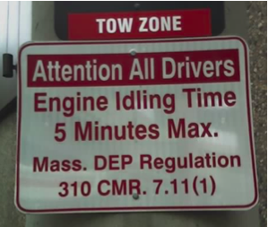
Basics: What’s Wrong with Idling? cont.
Air pollution
Harmful emissions, including greenhouse gases and those that cause smog
Potentially costly regulatory consequences
Noise
Idling is illegal in some states and municipalities
Notes:
In addition to the issues of fuel cost and consumption of nonrenewables and imports, idling has negative impacts on public health and the environment. Idling increases the amount of harmful emissions a vehicle produces, including greenhouse gases like CO₂ and nitrogen oxides (also called NOx), particulate matter, carbon monoxide, benzene, and other undesirable compounds. Many of these aggravate respiratory and cardiovascular problems, and researchers have identified some of them as carcinogens.
Children breathe more air per pound of body weight than do adults. For this reason, they take in proportionately higher “doses” of pollutants, which enter their lungs and, in some cases, bloodstream.
In addition to the public health effects associated with idling, areas with high levels of air pollution face regulatory and economic consequences.
The EPA, using its authority under the Clean Air Act, sets air quality standards. If a region fails to meet EPA’s National Ambient Air Quality Standards (also called “NAAQS”), it will be in “nonattainment.” Nonattainment is costly.
Nonattainment areas may face steep fines and become ineligible for federally funded highway projects. In 2010, for example, the EPA fined California’s San Joaquin Valley $29 million for failing to attain the 1-hour ozone standard. To pay such fines, local governments often must raise taxes. In the case of San Joaquin, vehicle registration fees were increased. Nonattainment status can dampen a region’s prospects for economic development.
One impact that’s not often discussed is the noise impact. Engine noise affects not only those who live and work nearby, but the vehicle operators themselves.
For these reasons and others, idling is simply illegal in some places.
More information about idling laws, and resources for keeping up with changes in them, will be given later in the presentation.

Slide 11
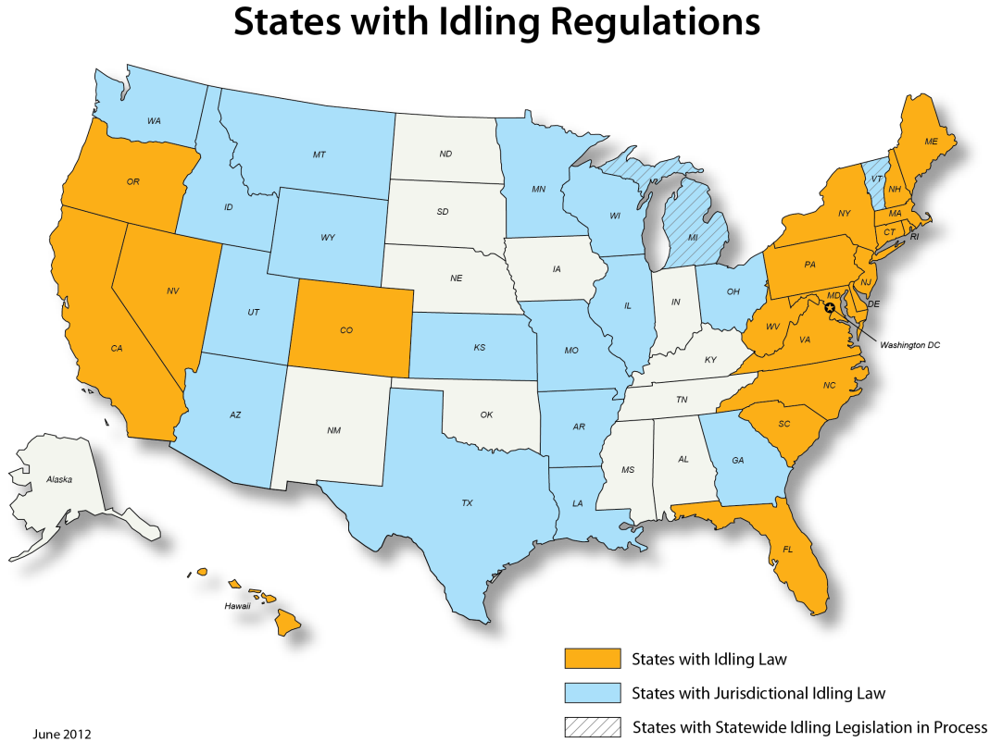
Basics: Idling May Be Against the Law
Notes:
In the last 10 years, states and municipalities have instituted idling laws in increasing numbers. These laws are usually developed in response to air quality concerns.
Failure to meet EPA’s NAAQS is one reason municipalities and regions institute idling laws. NAAQS noncompliance is not a trivial issue. Among other things, noncompliance status can lead to costly fines.
The laws primarily target larger diesel vehicles, but there are exceptions, especially at the local level. The map shown is current as of June 2012.
Keeping up with idling laws and their changes can be daunting. Idling laws differ not only by location (state, municipal, or county), but by vehicle type, vehicle weight, fuel type, outdoor temperature, and reason for idling. The list of exemptions—those for emergency vehicles, extreme temperatures, mandated driver rest periods—can be as long as the law itself.
In cases of violations, some laws penalize the driver, and others penalize both the driver and the vehicle owner. Imagine being the long-haul truck driver who must keep up with possibly dozens of idling regulations.
For information about heavy-duty truck idling laws in specific jurisdictions, go to atri-online.org and click on the ATRI Idling Compendium link at the top of the page.

Slide 12
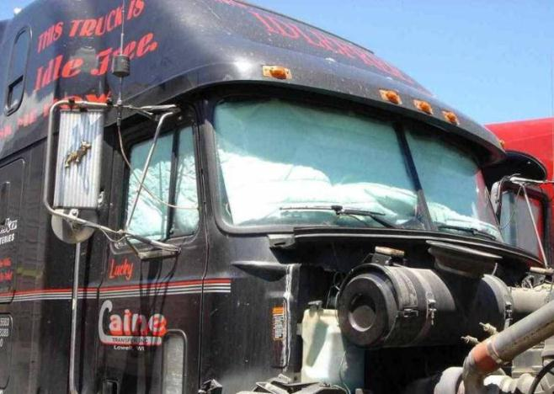
Idling can be reduced in several ways
Simply turn the engine off!
Reduce the need for power
Reduce heat transfer with insulation
Reduce solar load with shades or glazing
Recover waste heat from coolant
Reduce peak with load management
Can be retrofit or OEM option
Install idling-reduction technology
Get a hybrid vehicle

Slide 13
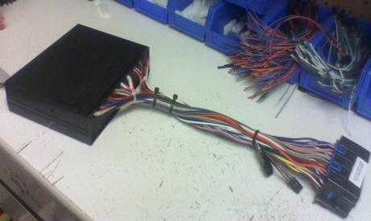
Engine controls are inexpensive
Timer shuts engine off after set time
Automatic start-stop senses cab temperature
Turns engine on when too warm or cold
Minimal savings in extreme weather
May disturb sleep
Adds to engine wear, emissions
Cylinder deactivation limits combustion to part of engine
Enables small reduction of fuel use and emissions
Not commercial
13

Slide 14
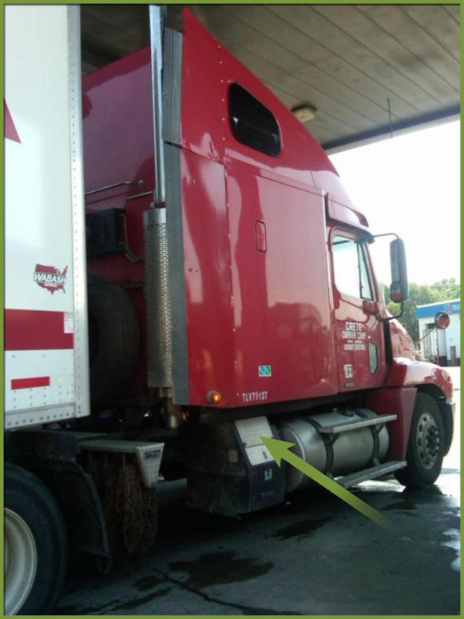
Availability: IR Equipment for Trucks and Buses
On-Board Options
Auxiliary power units (APUs)
Automatic engine stop-start controls
For heat (and/or engine warming) only
Fuel-fired heaters
Coolant heaters
Waste-heat recovery systems
Engine block heaters (to preheat engine)
For cooling only
Thermal storage cooling systems
Battery-electric air conditioners
Notes:
So, we know that for heavy-duty truck drivers, a “just turn the key” solution won’t cut it, especially for rest periods. Here we get into the technology solutions available for heavy-duty vehicles. We describe these options as either “on board” (on the vehicle) or “off board” (outside the vehicle).
Auxiliary power units (APUs) provide auxiliary power for heat, A/C, electronics, and other devices. APUs may be small, diesel-fueled engines or auxiliary batteries or power cells. The photo shows a truck equipped with a diesel-powered APU (arrow).
Automatic engine stop-start systems monitor vehicle battery charge and automatically turn the engine on to power HVAC when the cabin temperature falls below or rises above a preset level. This technology reduces, but does not eliminate, idling.
HEAT ONLY
Fuel-fired heaters supply warm air to the cab/sleeper.
Coolant heaters rely on the vehicle’s own heat-transfer system. The heater is mounted in the engine compartment and burns diesel fuel from the fuel tank to heat the vehicle’s coolant. The heated coolant is then pumped through the engine, radiator, and heater box. By keeping the engine warm, coolant heaters reduce the impact of cold starts. They may also be used to preheat the cabin.
Waste-heat recovery systems capture, or recycle, “excess” engine heat. They use the vehicle’s heat-transfer system, much like a coolant heater does, but with the addition of a device that keeps the truck’s heater operating after the engine is turned off. While these systems typically do not provide enough warmth to be a sole source of overnight heat, they provide enough heat for shorter stops.
Engine block heaters simply warm the engine for a preset amount of time before the vehicle (usually diesel fueled) is to be used. These are often used on school buses in cold climates.
COOLING ONLY
Thermal storage cooling systems use energy from the truck’s running engine to freeze ice for air conditioning when the truck is stopped and the engine off. With battery-electric air conditioners, energy from the running engine recharges a battery that powers air conditioning.
Both thermal storage systems and battery-electric air conditioners may offer a “plug in” option so that the units can draw power from an electrical pedestal.
The solutions for cooling are less advanced than those for heating.

Slide 15
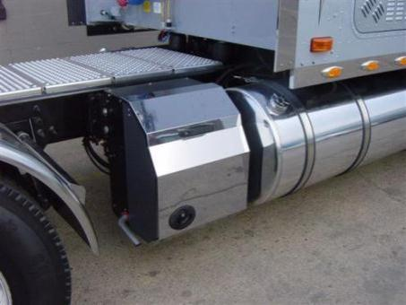
Various on-board designs provide full service
Supply HVAC, electricity, and charge battery
Auxiliary power unit (APU) or gen set
Diesel-fueled engine and generator
Some models can be plugged in
Fuel cell in development
Inverter/charger with batteries
Heat pump system now available
15
Notes:
These units are generally retrofit onto an existing chassis. An integrated new truck design that did not require 2 generators and 2 compressors would be smaller, lighter, and cheaper.

Slide 16
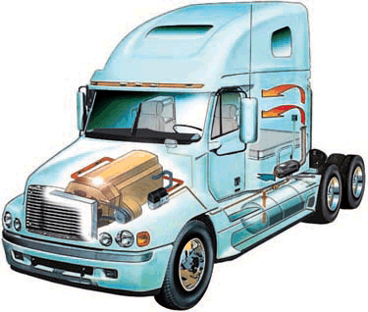
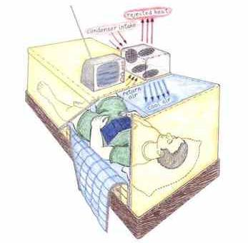
Heaters and air conditioners are available
Small, inexpensive, diesel-fueled heaters are efficient
For cab and engine
Used in Europe, on trucks, buses, boats
Waste heat recirculation is inexpensive
Most air conditioners rely on batteries
One system uses evaporative cooling
Thermal storage also available
May just cool bed
16

Slide 17
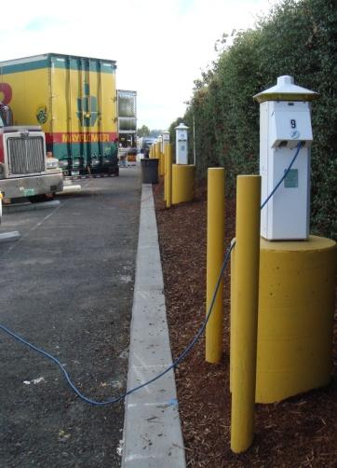
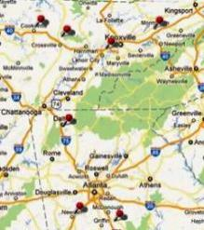
More Options for Trucks and Buses
Off-board Options
(Electrification)
Single-system
Hookup, via a window adaptor, provides heating, cooling, and amenities such as TV (no on-board equipment required)
Dual-system (shore power)
Power connection allows driver to plug in to power on-board equipment, such as heater, A/C, computer, and appliances such as microwaves
Find TSE sites for heavy-duty trucks at www.afdc.energy.gov/afdc/progs/tse_listings.php
17
Notes:
Electrified parking spaces (EPS) allow truck drivers to shut down their engines and plug in for electrical power. This technology is also called truck stop electrification (TSE). Electrified parking spaces have been available to recreational vehicle operators for awhile. There are two kinds of systems.
Single system electrification provides heating, cooling, and often amenities such as an internet connection, through a pedestal equipped with a duct. The truck needs no equipment other than a window adaptor to hold the duct that delivers cooled or warmed air from the pedestal.
Single-system service usually costs more per hour than does dual-system service.
Dual system electrification provides electrical power to trucks equipped to run heating, cooling, and other power needs electrically. Basically, trucks using this system are on “electric standby,” much like an RV at an RV park. The photo shows such pedestals.
Truck stop electrification is currently available in fewer than 100 locations, but the Truck Stop Electrification Project (STEP), funded by the DOE, is in the process of developing “electrified corridors” for the country’s most heavily traveled freight routes. Companies not associated with this project are also active in developing TSE sites.
The Alternative Fuels & Advanced Vehicles Data Center (AFDC) has a TSE locator website that can identify truck drivers identify the nearest TSE locations (inset).

Slide 18
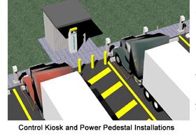
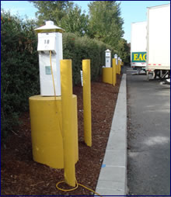
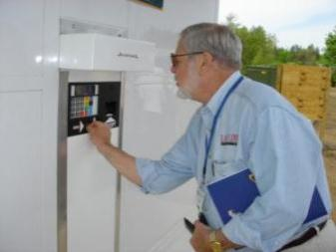
Dual system TSE* supplies electrical services
On-board electric HVAC required
Cost up to $2,500
Parking space costs up to $6,000
Plug-in pedestal like campground
Use costs $1.00/h
Standardized plugs desirable
120V and/or 240V AC
Payback projected <2 years for trucker
Can plug in reefer at some locations
Chicken and egg problem
*TSE= truck stop electrification, also called EPS= electrified parking space
18
Notes:
ARRA-funded STEP program aims to get around this by putting in stations covering major routes and equipping truckers that are committed to using them.

Slide 19
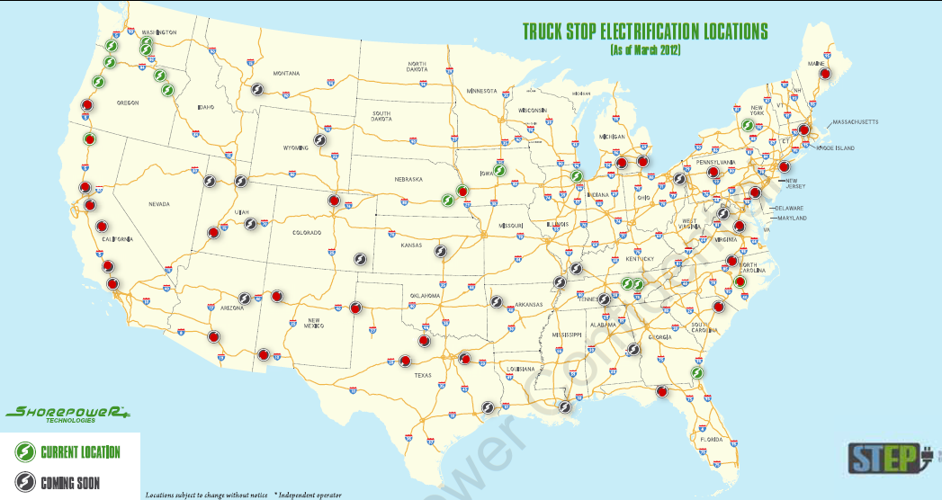
Dual System Locations
480 V e-TRU (reefer) connection
Notes:
What are the red dots on the ShorePower map?

Slide 20
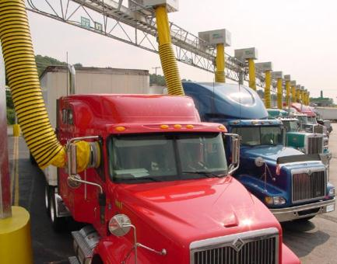
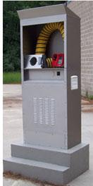
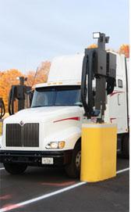
Single system electrified parking spaces require no investment by truck owner
Single system electrified parking spaces require no investment by truck owner
Single system electrified parking spaces require no investment by truck owner
User satisfaction high
No investment by truck owner
Costs less than fuel for idling
Truck stop gets part of revenues
System owner could sell emission credits
About 100 locations available nationwide
Several purveyors offer similar service
Can be used by any vehicle
Available for ambulances now
Notes:
Our analysis looked at the costs to the truck owner. However, for electrified parking spaces, there are also costs to the infrastructure owner, which in some cases have been supplemented by grants from air-quality agencies. The infrastructure owner must pay any staff at the site, and pay for electricity. These costs are defrayed by revenues from hourly charges, plus any extras like movies and training videos. There could also be carbon credits.

Slide 21
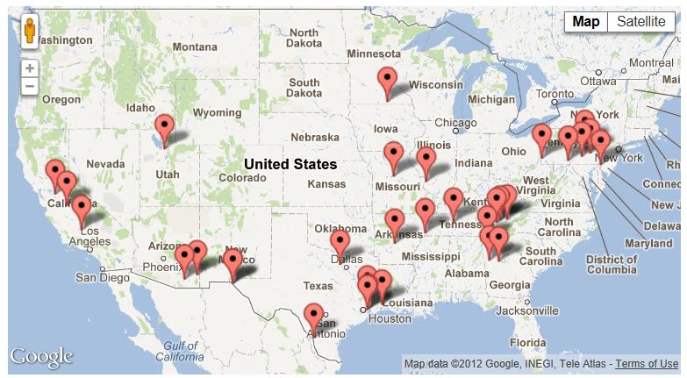
Largest Single System Purveyor’s Sites

Slide 22
Technologies have pros and cons
System | Services | Advantages | Disadvantages
Idling | All | No investment | High emissions, noise, fuel use
Automatic start-stop | All, intermittently | Low cost | Noisy, minimal benefit in winter
APU or similar device | All | Anywhere, anytime | High cost and weight
Truck stop electrification | All | No local emissions, pay-per-view, quiet | Requires equipped location, cost
Heater | Heating | Low cost and weight | Not full service
Air conditioner | Cooling | Low cost | Not full service, energy storage may be heavy

Slide 23
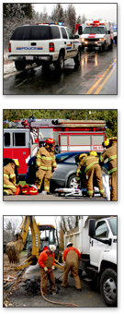
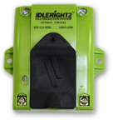
Options for Medium- and Light-Duty Vehicles
Driver Education, Policy Implementation, and/or Schedule Adjustments
Vehicle/fleet telematics (to monitor driver behavior, including idling time) can support education and policy.
Devices and Technologies
Idle limiters (engine shutdown timers)
Automatic engine stop-start controls with battery-charge monitor
Air and coolant heaters
Air heaters operate with a flame and blower
Coolant heaters circulate warmed engine coolant; can provide heat for several hours
Small fans (blow heat out of a hot vehicle)
12-volt air-conditioner for ambulance cab
23
Notes:
The simplest approach to idling reduction for light-duty and medium-duty vehicles is to educate drivers about when to turn the engine off. Policies to reduce unnecessary idling can also be set. A policy might state, for example, that vehicles may idle for no longer than 2 minutes.
Some fleets use GPS-based telematics technology to monitor driver behavior. These systems can provide alerts on behaviors associated with poor fuel economy, such as hard acceleration, hard braking, and, yes, unnecessary idling. The alerts can go to the fleet operations manager, to the driver, or both. Some companies have incentive programs for drivers who log low idling times, which is a great way to facilitate driver “buy in.”
Argonne National Laboratory has measured idling emissions on passenger cars. The data suggest that if you know you’ll be waiting for more than 10 seconds or so, you’ll save gas by turning off your engine. Waiting for freight trains to pass at railroad crossings, or waiting for bridges to open or close, may be other opportunities to turn off the engine. Little fuel is wasted by turning the engine off and back on in such circumstances. The “10-second rule” often cited is appropriate.
The California Energy Commission estimates that wear on engine components from repeated starting totals about $10 per year. The fuel savings from reduced idling will be many times that.
Some fleets have had success reducing idling times with schedule changes.
Many of the technologies available for heavy-duty trucks, such as air and coolant heaters, are available for smaller vehicles. Idle timers are a simple device that shuts off an engine after a specified period of idling. A number of police departments are using automatic stop-start controls with a battery-charge monitor or auxiliary battery packs. An example of the latter is shown on the slide. When police are on scene, their vehicles may be stationary for hours. The auxiliary battery pack allows law enforcement personnel to run lights and communication equipment without idling the engine.

Slide 24
Watch for IdleBox!
IdleBox, a soon-to-be-launched electronic “toolbox,” will include information on approaches to idling reduction, tools for educating drivers, and a national database of idling regulations (IdleBase) for on-road vehicles.
If you’d like to be alerted when IdleBox is launched, please give me your contact information after the presentation.
DRAFT poster from IdleBox

Slide 25
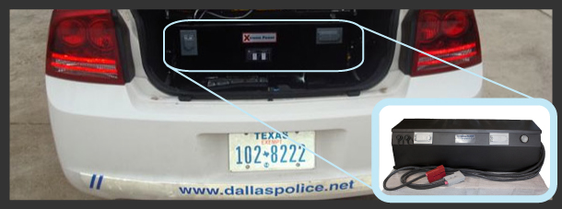
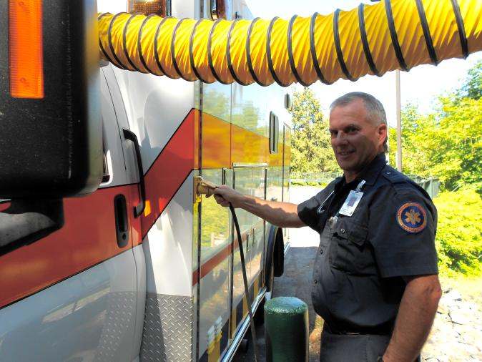
More Options for Medium- and Light-Duty Vehicles
Hybrid Drivetrain
Solves “creep” idling problem
Auxiliary Power
Auxiliary battery/power cells
Electrified Parking Spaces
Technology is emerging for some medium-duty vehicles such as ambulances
Some refrigerated trucks can plug into shore power
25
Notes:
When we talk about hybrids, we’re usually referring to vehicles with hybrid drivetrains. Hybrid drivetrain vehicles, however, are not available (or even currently viable) for all vehicle types. Especially for work vehicles, hybrid auxiliary power technology is a very active area of development. A standard diesel or gasoline vehicle may be outfitted to use an alternative energy source for some of its work, whether that’s providing climate control to the driver, running emergency lights, or operating a hydraulic lift (PTO). (For PTO, this is sometimes called, “workplace hybrid.”)
On passenger cars in the U.S., we’re starting to see a technology that’s already established in Europe: stop-start, sometimes called “idle stop” or microhybrid technology. Vehicles equipped with stop-start shut down the engine and draw battery power when the vehicle is stopped, which reduces fuel use and emissions. The transition between engine power and battery power is designed to be seamless. This feature is not available (to date) on trucks in the U.S.
Electrified parking space technology, already used for long-haul trucks, is emerging for some medium-duty vehicles. The slide shows an ambulance “plugged in” to a MediDock unit at Brattleboro Hospital in Brattleboro, Vermont. The ambulance driver shuts off the engine and plugs in to power vehicle electronics and medical equipment. The benefits of reducing diesel exhaust near hospital emergency rooms are especially obvious.

Slide 26
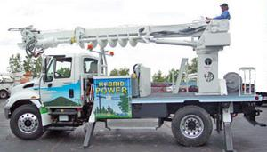
Hybridization can reduce idling for PTO or in queues
Type of Hybrid | Hybrid Drivetrain | Hybrid PTO | Companies | Comments
Hydraulic | X |  | Eaton | Eliminates creep idle
Battery Plug-In | X | X | Odyne | Li-ion battery, eliminates creep idle
Battery |  | X | Vanner | Monitors battery when using PTO
Hybrid digger derrick with turret-mounted winch

Slide 27
SmartWay verifies idle-reduction technologies
EPA has determined that devices among the product lines of the following companies save fuel and reduce emissions when compared to idling the main engine for Class 8 trucks. Separate verification is required for each vehicle type.
Electrified parking spaces: CabAire, Craufurd, EnviroDock, IdleAire, Philips and Temro, Shorepower™, Xantrex
Auxiliary Power Units and Generator Sets (APU/GS): ACEMCO, Airworks, Big Rig, Carrier Transicold, Diamond, Dunamis, Hodyon, Kohler, Life Force, Mantis, McMillan, Midwest, Navistar, Parks, Pony Pack, Power Technology Southeast, RigMaster, Star Class, Thermo King, TRIDAKO, Volvo, Willis
Fuel-operated heaters: Automotive Climate Control, Espar, Teleflex, Volvo, Webasto
Battery air-conditioners: All Around Contracting, AuraGen, Bergstrom, Cool Moves, DC Power, Diamond, Dometic, Driver Comfort, Energy Xtreme, Freightliner, Glacier Bay, Hammond, Idle Free, Indel, NAS, Navistar, Paddock Solar, Peterbilt, Safer, Sobo, Sun Power, Thermo King, Volvo
Thermal storage systems: Autotherm, Webasto

Slide 28
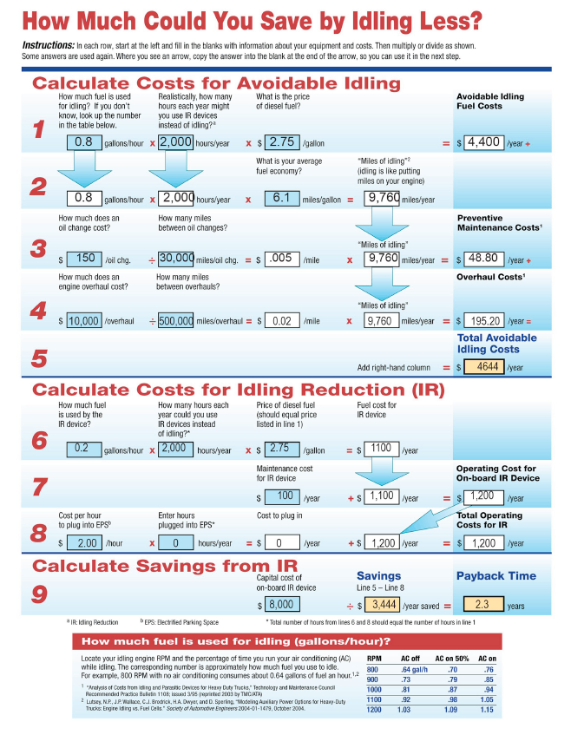
You can estimate your payback period for idling
The more you idle, the more you can save!
Idling reduction equipment can pay for itself quickly
Worksheets for trucks and cars available on Argonne website

Slide 29
Estimated costs for alternatives vary widely
Data for Class 8; costs and energy use would be lower for medium-duty trucks.
System | Services | Fuel Use/hr | On-board cost ($) | Maintenance ($/hr) | Infrastructure cost ($/space) | Usage Charge ($/hr)
Idling truck | All | 0.6-2 gal | 0 | 0.12 | 0 | 0
Cab/bunk heater | Heating | 0.04-0.08 gal | 1,250 | 0.05 | 0 | 0
Storage AC | Cooling | ~0.20 gal | 4,000 | 0.13 | 0 | 0
APU or gen set | All | 0.25-0.40 gal | 8,500 | 0.20 | 0 | 0
Single-system EPS | All | ~2 kWh | 10 | 0 | Pedestal 10,00-12,000 Refurbished gantry 5,000-9,000 | 2
Dual-system EPS | All | ~1.5 kWh | 50-2500 | 0.07 | Up to 6,000 | 1
Notes:
We did an informal survey of equipment manufacturers to estimate costs for installation, fuel, maintenance, and hourly charges of the most popular idling-reduction options, and then used these approximate costs to estimate total costs to the truck owner under varying scenarios. Note that there is significant variation among manufacturers.

Slide 30
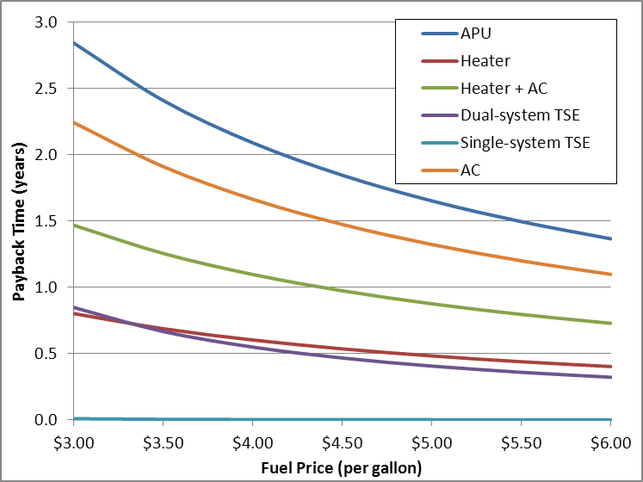
Idling reduction is the low-hanging fruit of fuel economy
Idling reduction equipment pays for itself in 6 months to 2 years (at 2012 fuel prices). This graph represents the payback time for a long-haul truck that idles an average of 40 hours per week.
30
Notes:
Idling reduction is often called the “low-hanging fruit of fuel economy.” Unlike some other approaches to maximizing fuel economy and reducing emissions, idling reduction is something almost any driver can start doing today.
For idling reduction not related to overnight driver rest periods or PTO work, no investment may be required. Fuel savings and emission reductions are immediate. A driver can save a little money each week, reduce engine wear, and contribute to cleaner air.
The graph on the slide shows how, even for the more-complicated issue of heavy-duty trucks, idling reduction is often a low-hanging fruit. Payback time depends on how much a vehicle idles. The more idling hours displaced, the faster the payback. For vehicles that idle little, capital-intensive systems are slow to pay back. For vehicles that idle a lot, operating cost becomes a key factor.
On the figure, “APU” refers to “auxiliary power units.” “AC” is “air conditioning.” “Dual-system TSE” and “Single-system TSE” refer to truck stop electrification, which we’ll discuss in an upcoming slide.

Slide 31
How can we implement—and afford—idling reduction?
Bank loans
National grants, loans, and rebates
EPA’s Diesel Emissions Reduction Program (DERA)
EPA SmartWay Finance Program
Manufacturer rebates and loans
Nonprofit organizations (e.g., Cascade Sierra Solutions)
State grants and loans (including programs targeted to small businesses)
State Clean Diesel grant programs (EPA) and Congestion Mitigation and Air Quality (CMAQ [DOT]) grant programs
Some other state agencies and programs
Notes:
In addition to bank loans, there are programs that offer grants, loans, and rebates for idling reduction equipment.
Grant, loan, and rebate programs are, of course, subject to change. For example, EPA’s Diesel Emissions Reduction Act (DERA) program is slated for a sharply reduced budget in fiscal year 2013. The program’s focus will shift from grants to low-interest loans and rebate programs.
For those who dread grant-application paperwork, a shift to rebates may be welcome.
Many programs, including some not directly related to DERA, require that technologies be EPA SmartWay verified. If you plan to apply to one of these programs, it’s important to check whether the devices you’re considering are SmartWay verified.
Fleets that have trucks operating in California will also want to confirm that devices are approved by the California Air Resources Board (“CARB approved”).
Many state governments also offer funding options:
Arkansas Department of Environmental Quality
California Air Resources Board
Minnesota Pollution Control Agency
New York State Energy Research and Development Authority
North Central Texas Council of Governments
Pennsylvania Small Business Advantage Grant Program
Our coalition can help you identify funding opportunities and may be able to help with application paperwork. For coalition stakeholders, we offer the following assistance [describe what your coalition offers].

Slide 32
For More Information
A free monthly, electronic newsletter that provides:
Information about current funding opportunities and recent awards
News about changes in ordinances, laws, regulations, and enforcement
Alerts about upcoming meetings, events, and other resources of interest
Links to idling cost calculators and other idling reduction resources
www.eere.energy.gov/vehiclesandfuels/resources/fcvt_national_idling.html
32
Notes:
If you don’t want to write down the long URL for “National Idling Reduction Network News,” just do a Google search on the newsletter’s title. The newsletter link will likely show up after you enter “National Idling.”

Slide 33
For More Information
Argonne National Laboratory’s Idling Reduction Page
www.transportation.anl.gov/engines/idling.html
Alternative Fuels & Advanced Vehicles Data Center (AFDC) Idling Reduction Page
http://www.afdc.energy.gov/conserve/idle_reduction_basics.html
National Idling Reduction Network News
www.eere.energy.gov/vehiclesandfuels/resources/fcvt_national_idling.html
SmartWay Verified Technologies
http://www.epa.gov/smartway/technology/index.htm
American Transportation Research Institute’s Compilation of Idling Regulations
http://atri-online.org/2012/07/20/idling-regulations-compendium/
33
Notes:
Of all of the approaches to saving fuel and reducing emissions, idling reduction offers the most promise for low-investment, real-time fuel savings.
Argonne National Laboratory’s idling page includes worksheets, available as Excel files, for calculating idling costs.
The Alternative Fuels and Advanced Vehicles Data Center contains a wealth of information, including material on fuel and vehicle basics, emissions, availability, fleet experiences, industry contacts, and several other topics.
Information is available from Clean Cities coalition coordinators and online. Argonne is in the process of creating additional outreach materials, as shown on the right.

Slide 34
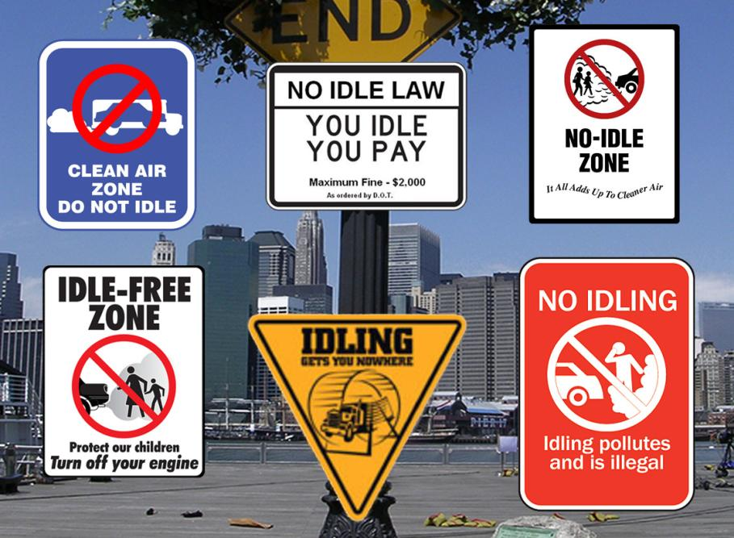
For More Information
Linda Gaines
lgaines@anl.gov
630/252-4919
34
Notes:
Thanks to audience
Q & A
More about our coalition and how we can help you implement an idling reduction strategy?

