Slide 1
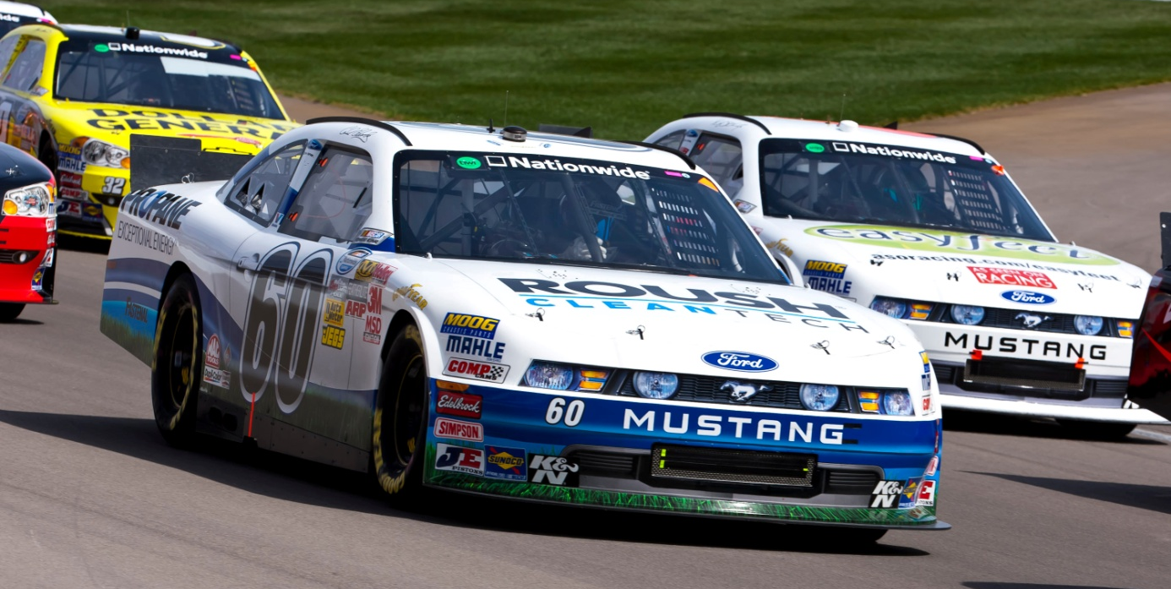
The Race to Energy Independence
With Propane Autogas
10.03.12

Slide 2
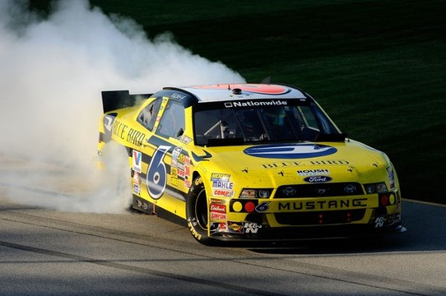
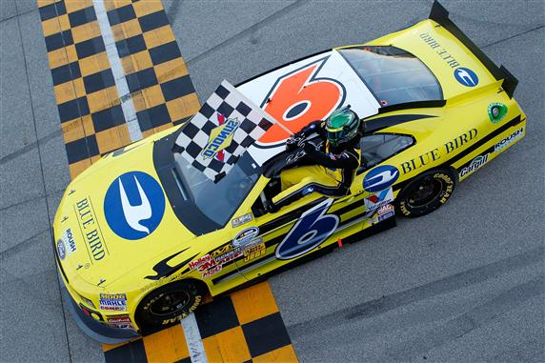
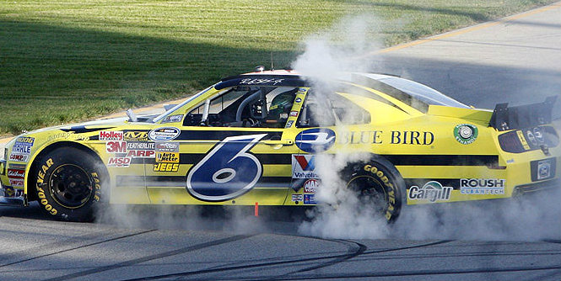
Blue Bird Wins at Chicagoland

Slide 3
Corporate Overview
Corporate Wheel of Capability

Slide 4
ROUSH Enterprises Brand Portfolio
Roush Fenway Racing
Dominant NASCAR Sprint Cup racing team.
ROUSH Performance
Industry leading high performance vehicles.
ROUSH Life Sciences
Setting a new standard in medical equipment
design, manufacturing, and engineering.
ROUSH Industries
OEM quality manufacturing, engineering,
prototyping, and design capabilities.

Slide 5
Factors for Alt Fuel Analysis
Economics
Energy Independence
Environmental Responsibility

Slide 6
ROUSH Enterprises Brand Portfolio
ROUSH CleanTech
Dedicated to developing quality alternative fuel solutions.
Propane autogas focus.
EPA and CARB certification ability.
Platform customization to suit customer needs.
Reduces operating costs, carbon footprint.
OEM support through Ford and BPN dealers.
Creating opportunities for partner companies.
Using American fuel and American technology.

Slide 7
Product overview:
Pickups | Vans & Wagons | Cutaway Vans
Chassis Cab | School Bus

Slide 8
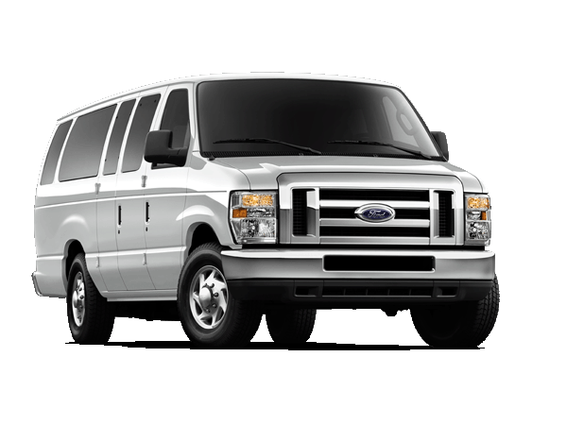
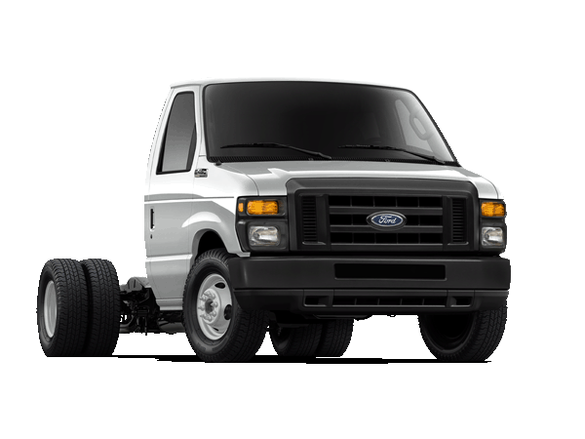
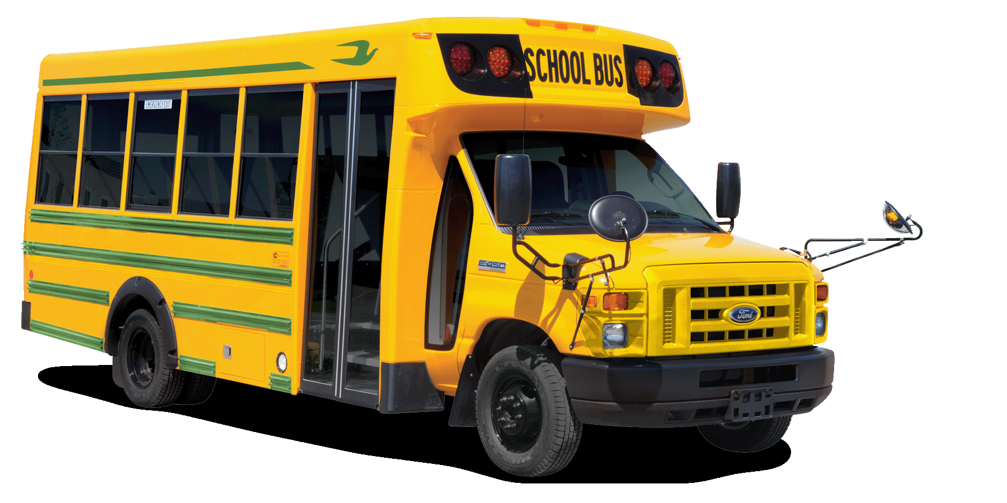
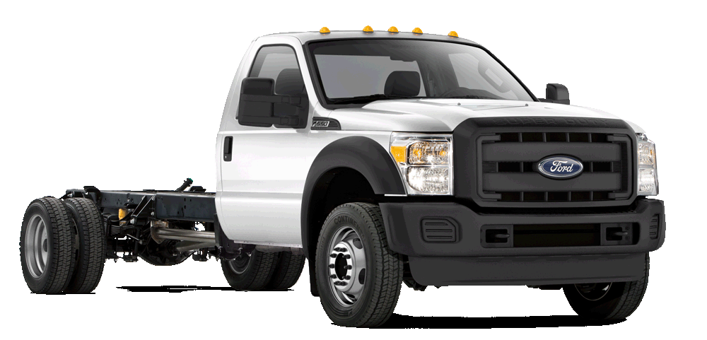
ROUSH CleanTech Products
Liquid Propane Autogas Vehicles
Light & medium duty Ford trucks & vans, school bus.
Factory Ford warranty maintained.
No loss of HP / torque / towing capacity.
Serviceable with existing diagnostic equipment.
EPA & CARB Certified.
Ford E-150 / E-250 / E-350
Ford E-450 DRW Cutaway
Ford F-450 / F-550
Micro Bird G5 School Bus
Blue Bird Vision School Bus

Slide 9
Product Overview – Vans & Wagons
Ford E-150 / E-250 / E-350
Model Years: 2009 – 2013
Engine Size: 5.4L V8 (2V)
Applications: Extended or Regular
Cargo Van, Club Wagon,
All rear-axle configurations
4-speed automatic transmission
Tank Sizes: Mid-Ship: 25 usable gallons
In-Cab: 46 usable gallons
Technical Specs: EPA and CARB approved
GVWR: < 10,000 lbs.
Requires “91G” gaseous fuels prep package.
Order Availability: Ford Ship Through
Conversion Kits

Slide 10
E-series Mid-Ship Fuel Tank
FRPCM
The Fuel Rail Pressure Control
Module ensures consistent vehicle
performance and power on-demand.
Fuel Rail
ROUSH CleanTech’s signature
blue anodized aluminum fuel
rail is designed to operate
under varying temperatures
of liquid propane
Fuel Fill
Industry-standard valve designed to
allow for safe passage of liquid pro-
pane into the vehicle. Includes a
check valve to prevent fuel leaks.
Fuel Tank
The liquid propane autogas fuel tank
meets all ASME certification standards,
is made of ¼ inch thick steel, and is
built and assembled in the USA.
Fuel Injectors
Special fuel injectors are used
to inject liquid propane into the
cylinders for ignition.
Fuel Lines
Made of high-durability stainless
steel to handle varying temperatures
and pressures. They are designed to
route through the factory line locations.

Slide 11
Product Overview – Vans & Wagons
Ford E-450 DRW Cutaway
Model Years: 2009 – 2013
Engine Size: 6.8L V10 (2V)
Applications: 158” or 176” wheelbase
Stretched Chassis
5-speed auto transmission
Tank Size: Aft-Axle: 41 usable gallons
Technical Specs: EPA and CARB approved
GVWR: < 14,500 lbs.
Requires “91G” gaseous fuels prep package.
Order Availability: Ford Ship Through
Conversion Kits

Slide 12
E-450 Cutaway Aft-Axle Fuel Tank
FRPCM
The Fuel Rail Pressure Control
Module ensures consistent vehicle
performance and power on-demand.
Fuel Tank
The liquid propane autogas fuel tank
meets all ASME certification standards,
is made of ¼ inch thick steel, and is
built and assembled in the USA.
Fuel Fill
Industry-standard valve designed to
allow for safe passage of liquid pro-
pane into the vehicle. Includes a
check valve to prevent fuel leaks.
Fuel Rail
ROUSH CleanTech’s signature
blue anodized aluminum fuel
rail is designed to operate
under varying temperatures
of liquid propane
Fuel Injectors
Special fuel injectors are used
to inject liquid propane into the
cylinders for ignition.
Fuel Lines
Made of high-durability stainless
steel to handle varying temperatures
and pressures. They are designed to
route through the factory line locations.

Slide 13
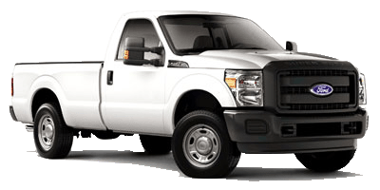
Product Overview - Pickups
Ford F-250 / F-350
Model Years: 2012 - 2013
Engine Size: 6.2L V8 (3V)
Applications: 4x2 or 4x4
All bed configurations
All body configurations
All rear axle configurations (including chassis cab)
Tank Sizes: Under-Bed: 25 usable gallons
In-Bed: 38 usable gallons
Technical Specs: EPA and CARB approved
GVWR: ≤ 13,300 lbs.
Requires “98F” gaseous fuels prep package.
Order Availability: Ford Ship Through
Conversion Kits
Available October, 2012

Slide 14
F-250 Under-Bed Fuel Tank
FRPCM
The Fuel Rail Pressure Control
Module ensures consistent vehicle
performance and power on-demand.
Fuel Rail
ROUSH CleanTech’s signature
blue anodized aluminum fuel
rail is designed to operate
under varying temperatures
of liquid propane
Fuel Fill
Industry-standard valve designed to
allow for safe passage of liquid pro-
pane into the vehicle. Includes a
check valve to prevent fuel leaks.
Fuel Tank
The liquid propane autogas fuel tank
meets all ASME certification standards,
is made of ¼ inch thick steel, and is
built and assembled in the USA.
Fuel Lines
Made of high-durability stainless
steel to handle varying temperatures
and pressures. They are designed to
route through the factory line locations.
Fuel Injectors
Special fuel injectors are used
to inject liquid propane into the
cylinders for ignition.

Slide 15
Product Overview – School Bus
Blue Bird Vision
Model Years: 2012 - Newer
Engine Size: 6.8L V10 (3V)
Applications: Blue Bird Vision
Blue Bird MFSAB / Activity Bus
Tank Sizes: 67 usable gallons
Technical Specs: EPA and CARB Approved
Up to 77 Passengers
GVWR: 33,000 lbs.
Order Availability: Blue Bird Dealers

Slide 16
Product Overview – School Bus
Ford E-450 DRW Cutaway
Model Years: 2009 – 2012
Engine Size: 6.8L V10
Applications: Dual rear wheel cutaway
5-speed auto transmission
Tank Sizes: Aft-Axle: 41 usable gallons
Technical Specs: EPA and CARB Approved
Up to 30 Passengers
GVWR: 14,500 lbs.
Order Availability: Blue Bird Dealers

Slide 17
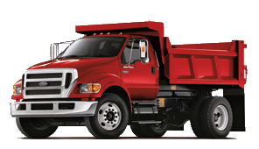
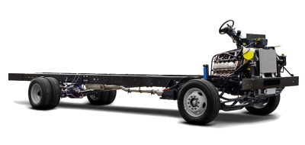
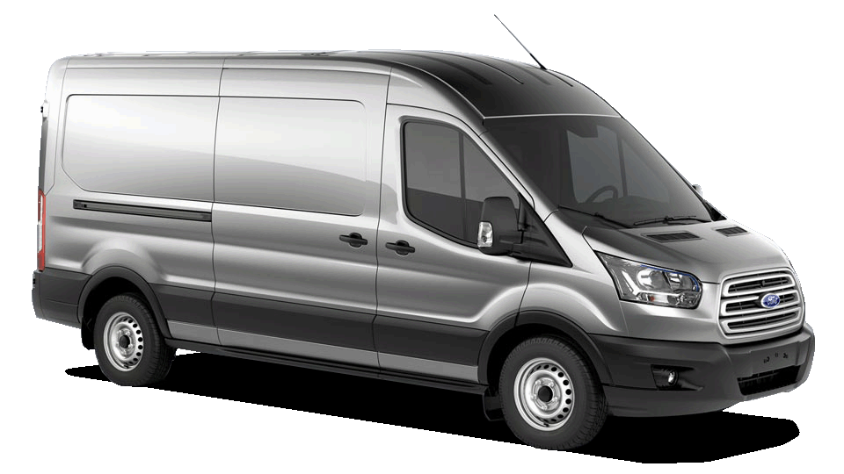
Product Overview - Future
Ford F450/550/h650
6.8L V10 (3V)
Ford F-59 Strip Chassis
6.8L V10 (3V)
Ford Transit
3.7L V6
Ford F-650
Ford F-59 Strip Chassis
Ford Transit

Slide 18
Return on investment
A Positive Return, Even Without
Government Incentives

Slide 19
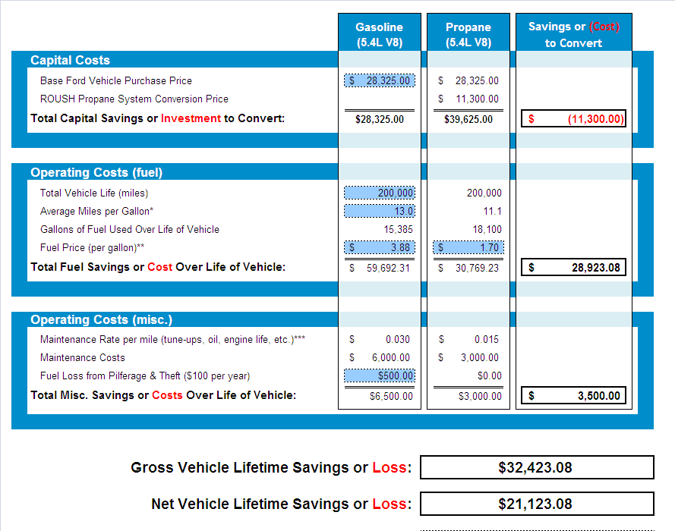
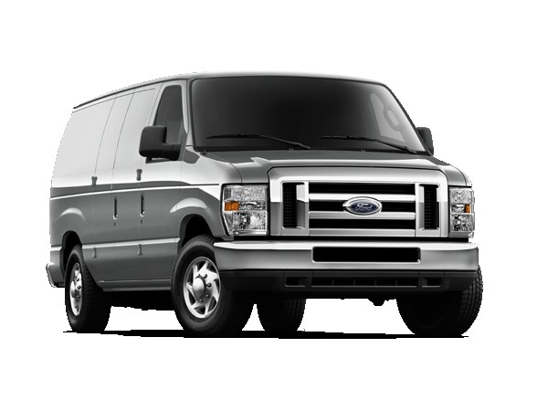
Savings Calculator
2012 Ford E-250 Cargo Van

Slide 20
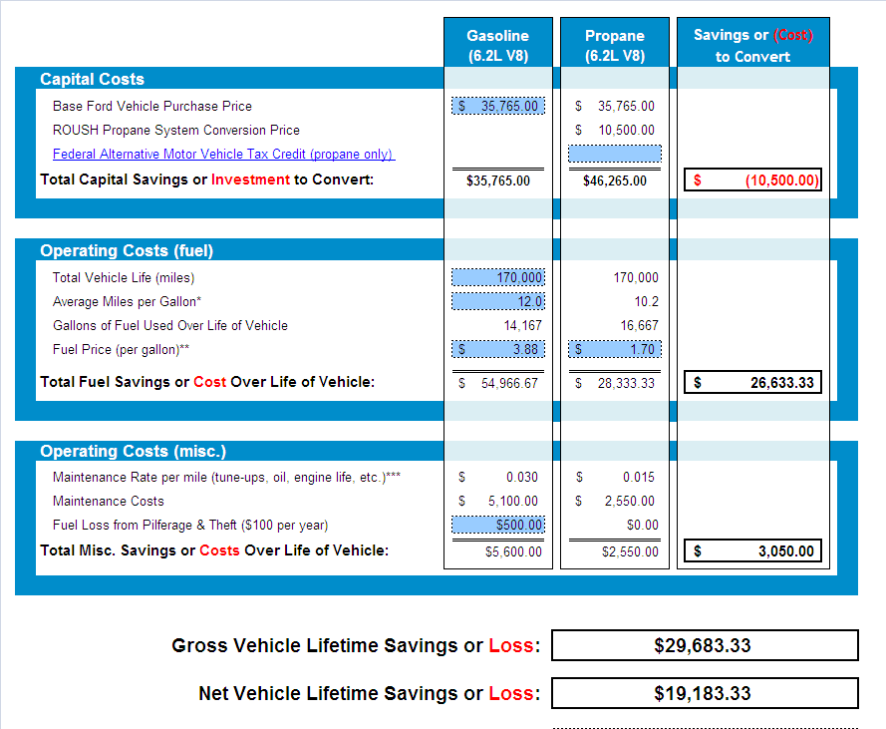
Savings Calculator
2012 Ford F-250 Pickup Truck

Slide 21
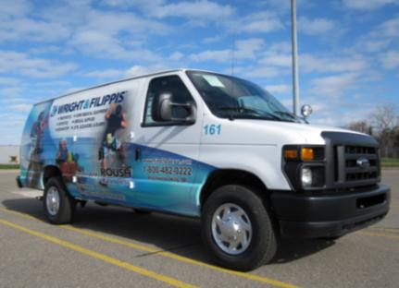
Case Study – Wright & Filippis
Industry: Home Medical Equipment
Location: Rochester Hills, MI
Vehicles: Ford E-350 Cargo Vans
Ford E-450 Cutaway Vans
By The Numbers:
48,000 fewer gallons of gasoline / year
931,200 fewer lbs of CO₂ / year
$36,000 reduction in fuel costs / year
“Our experience so far has been very positive. The vehicles are performing very well, we are seeing real fuel savings and the transition has been quite easy. I couldn’t be happier with our project at this point. Because of this, we have already expanded the scope of our year-one project.”
- Tom Hopkins, Distribution & Fleet Manager

Slide 22
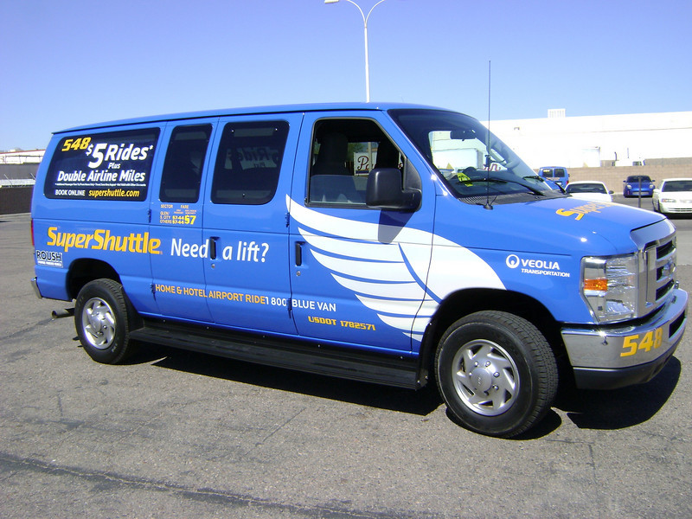
Case Study – SuperShuttle
Industry: Airport Transportation
Location: Phoenix, AZ
Vehicles: 35 Ford E-350 Passenger Vans
By The Numbers:
10,000 fewer gallons of gasoline / van / year
300,000 fewer lbs of CO₂ / van
$14,500 reduction in fuel costs / van / year
“The switch to propane autogas was the smart thing to do. We are seeing tremendous fuel savings right now. Gas prices in Arizona are averaging $3.65 / gallon [in mid-April, 2011]. Our drivers who are using public propane refueling infrastructure around Phoenix are paying $2.20 per gallon.”
- Ken Brooks, National Purchasing Manager

Slide 23
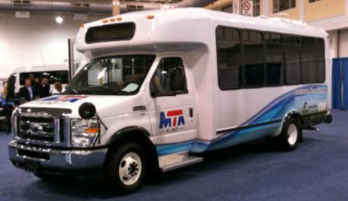
Flint Mass Transit Authority
Industry: Para-transit
Location: Flint, MI
Current Vehicles: 10 E-450 shuttle buses
Future Vehicles: 60 E-450 shuttle buses
By the Numbers:
$1.26 per gallon for propane autogas for the
next twelve months.
83,000 fewer pounds of CO₂ per shuttle bus.
“Propane autogas is a good fit for us. We anticipate purchasing propane fuel for half the price of diesel. It will reduce our dependency on diesel and drive down our cost of operation.”
– Edgar Benning, general manager, Flint Mass Transit Authority

Slide 24
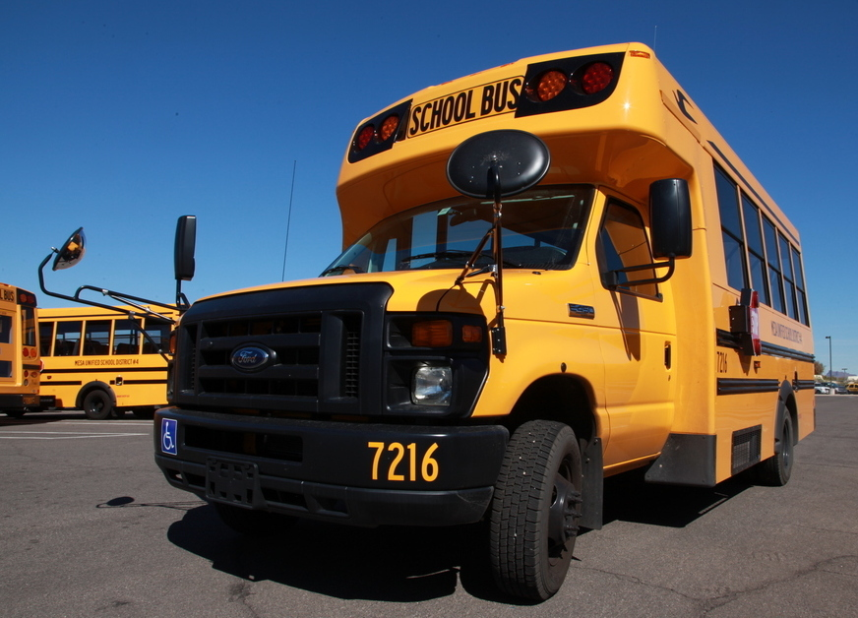
Mesa Public Schools
Industry: Education
Location: Phoenix, AZ
Vehicles: Micro Bird G5 Type A school buses
Blue Bird Type C school buses
F-250 pickup trucks
By The Numbers:
60% fuel savings per gallons compared to diesel
$5,667 reduction in fuel costs / year
“I’m conservative when I run numbers, and the savings were amazing. Not only with fuel and maintenance, but the initial upfront costs were also considerably cheaper than comparable diesel-powered buses would have been,” says Latko. “We’re saving a total of 32.6 cents per mile with propane autogas.”
- Ron Latko, Director of Transportation and Vehicle Maintenance

Slide 25
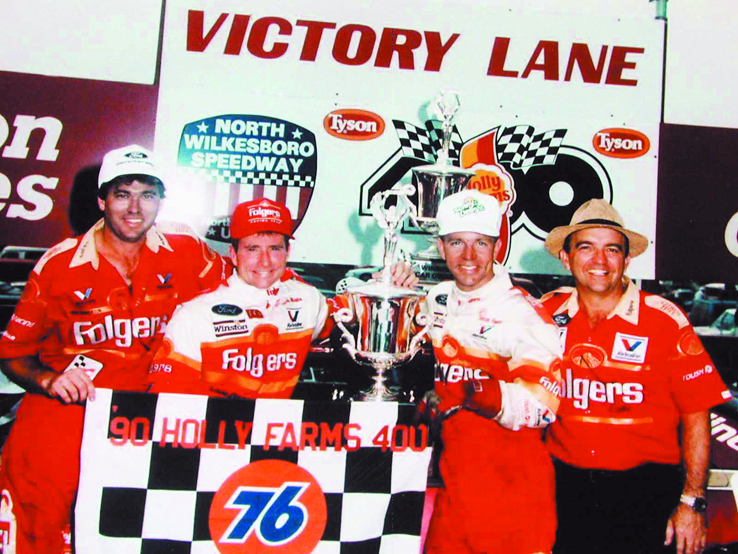
ROUSH & NASCAR
Roush Fenway Today:
Taken 87% of our partners to Victory Lane

Slide 26
Contact us:
800.59.ROUSH
ROUSHcleantech.com
Todd Mouw
Vice President, Sales & Marketing
734.466.6522
Todd.Mouw@roush.com

