Slide 1
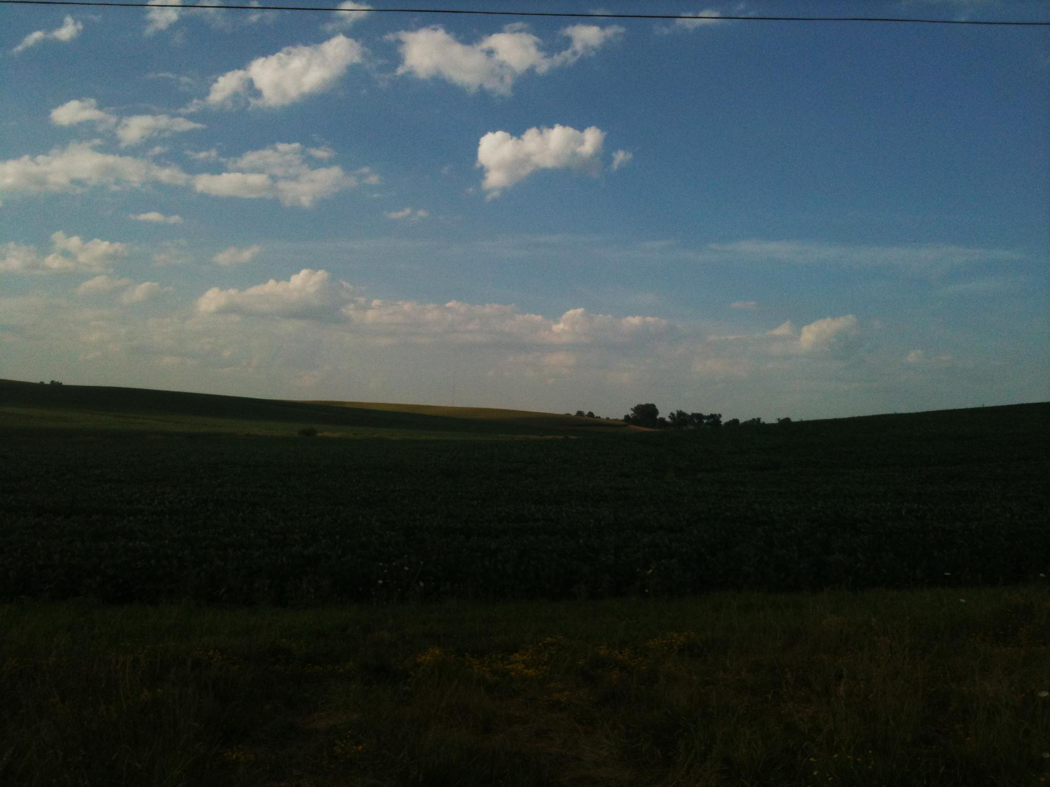
America’s Advanced Biofuel
Don Scott
Director of Sustainability

Slide 2
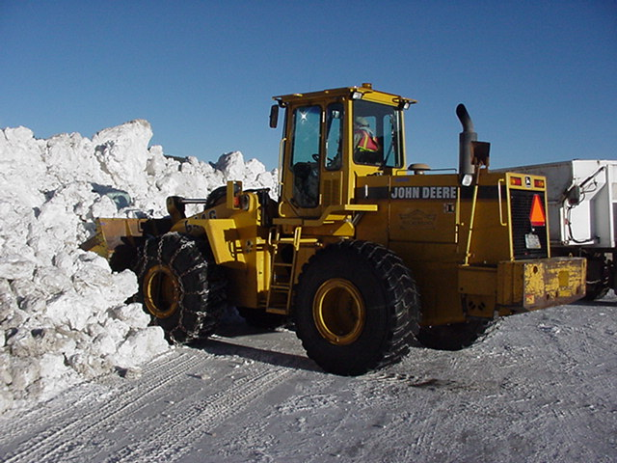
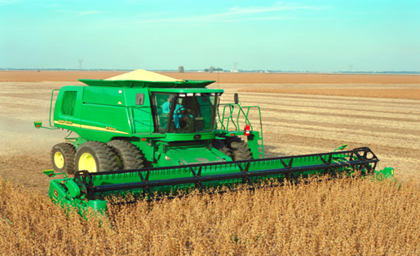
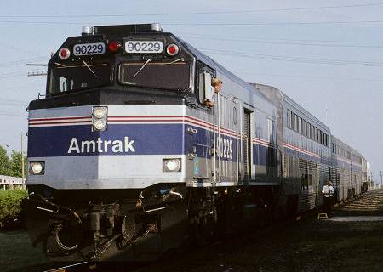
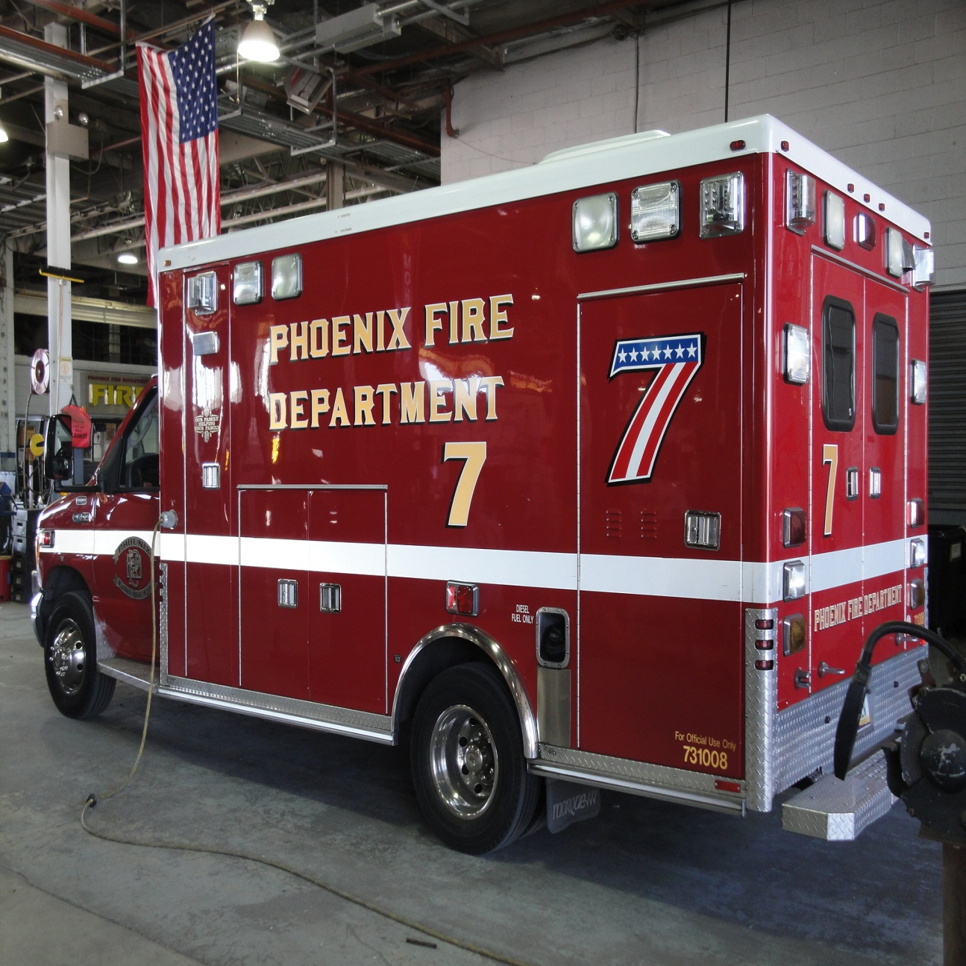
Liquid Fuel is a Necessity
Notes:
We rely on liquid fuels for almost every aspect of food production, food distribution, commerce, and public safety. For the multitude of vehicles upon which we rely, especially heavy duty equipment, liquid fuel is the safest, densest, and most economical way to store energy.

Slide 3
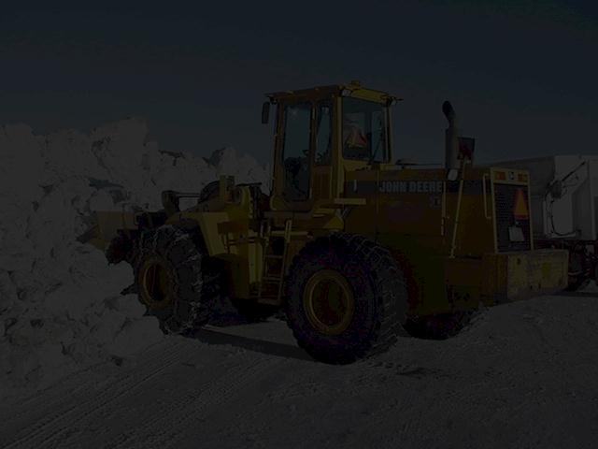
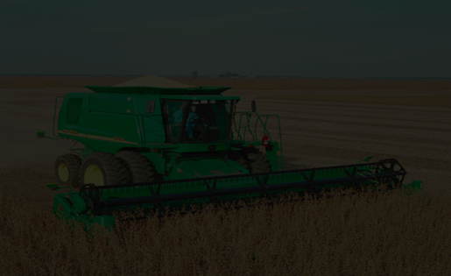
We must have Liquid fuels that are:
Renewable,
Energy Efficient,
Environmentally Friendly, and
Recycle Carbon.

Slide 4
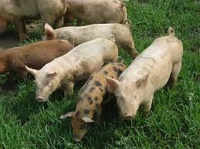
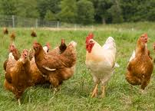
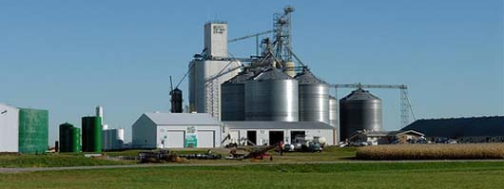
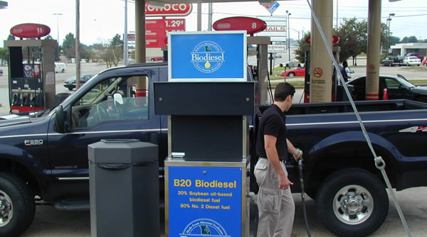
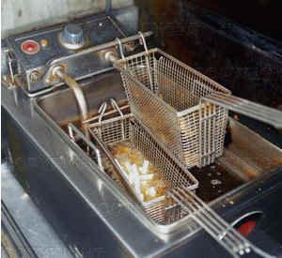
What is Biodiesel?
A renewable fuel commercially refined from a diverse array of fats and oils
by-products & used in normal diesel engines

Slide 5
Biodiesel Defined
Biodiesel, n. -- a fuel comprised of mono-alkyl esters of long chain fatty acids derived from vegetable oils or animal fats,
meeting ASTM D 6751.

Slide 6
Biodiesel stores solar energy.
Plants store energy in natural oils.
Plants capture carbon from the air.
We can harness solar energy for diesel engines as part of this natural cycle,
and we can do it efficiently.

Slide 7
Biodiesel has the best energy balance.
Every unit of fossil energy put into producing biodiesel, yields 5.5 units of usable energy.
Biodiesel reduces GHG emission by 85-89%*

Slide 8
Biodiesel Lowers Emissions
Emission Type | B100 | B20 | B2
Total Unburned Hydrocarbons | -67% | -20% | -2.2%
Carbon Monoxide | -48% | -12% | -1.3%
Particulate Matter | -47% | -12% | -1.3%
Polycyclic Aromatic Hydrocarbons | -80% | -13% | -1.3%
Lifecycle Carbon Dioxide | -85% | -17% | -1.7%

Slide 9
Better For Your Health
Biodiesel is:
Nontoxic:
LD50 =17.4 g/Kg - less toxic than table salt
Skin irritation less than that of 4% soap and water solution
Safer to handle: Flash point above 200 Degrees F, Non-Reactive, Non-Corrosive

Slide 10
Economic Benefits
Biodiesel helps our U.S. economy and improves our balance of trade.
Using biodiesel creates added outlets for farm based products and wastes
Biodiesel creates manufacturing jobs.
Revenue circulates through our local economies instead of being exported in exchange for imported oil.

Slide 11
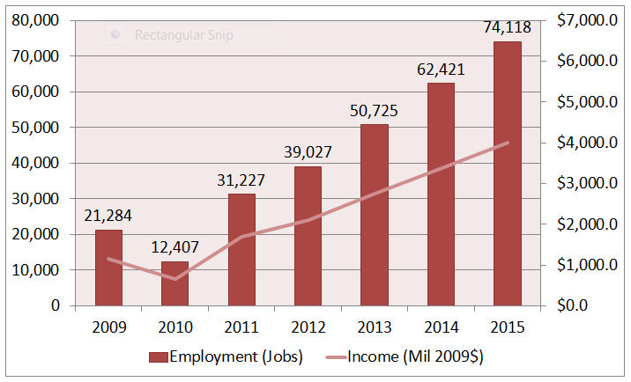
Jobs, Jobs, Jobs

Slide 12
Biodiesel: An “Advanced Biofuel” Available Now
205 EPA-Registered plants nationwide with over 3.08 Billion GPY Capacity

Slide 13
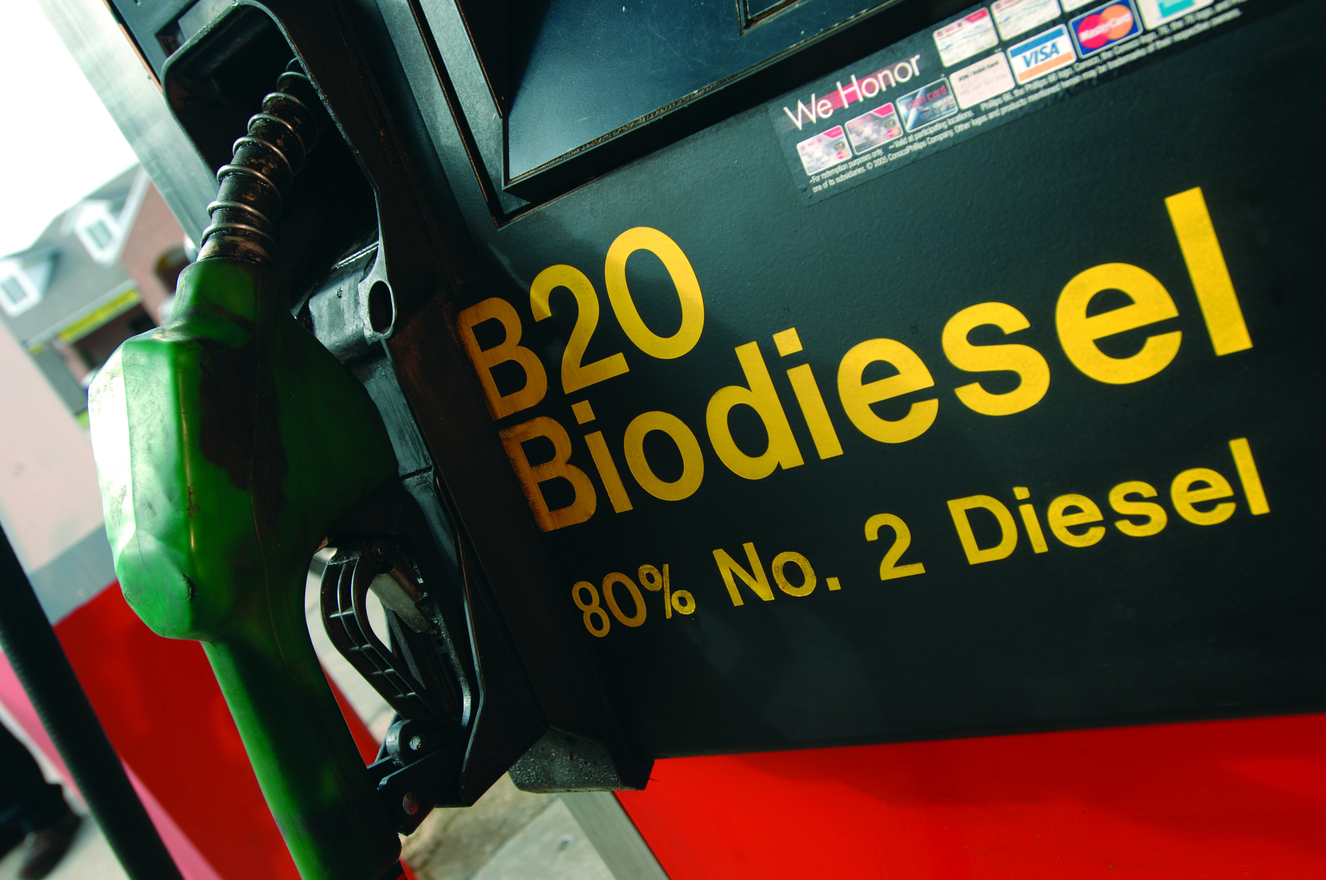
Ease of Use & Performance
Using Biodiesel is easy!
B20 and lower blends are a drop-in replacement for diesel fuel; no vehicle modifications needed
Can be used in any diesel engine / vehicle according to OEM’s recommendations
www.biodiesel.org/using-biodiesel/oem-information/oem-statement-summary-chart for OEM positions
No loss of engine performance, fuel economy
Dispensed through existing fueling stations

Slide 14
OEM Warranty Statements
All major OEMs selling diesel equipment in the U.S. support at least B5 and lower blends, provided they are made with biodiesel meeting ASTM D 6751
Most OEMs are also recommending use of a BQ-9000 supplier
10 new OEM statements of B20 support so far in 2012, with more expected soon!
More than 95% of the medium- and heavy-duty truck markets now support B20
For a complete listing of OEM position statements on biodiesel, as well as the current U.S. Diesel Vehicles List, visit: www.biodiesel.org/using-biodiesel/oem-information

Slide 15
OEMs Supporting B20+

Slide 16
OEMs Supporting B20+
New OEM B20 Support Statements in 2012:

Slide 17
Current B5 Positions
Approve B5:
Audi **
BMW
Mazda
Mercedes
Mitsubishi **
PACCAR:
Peterbilt/Kenworth
Volkswagen **
** Actively researching B20

Slide 18
Fuel Quality
Biodiesel must meet D 6751 to be entered into commerce.
ASTM specification D 6751 for B100
D 975 for B5 in diesel fuel
D 396 for B5 in heating oil
D 7467 for B6-B20

Slide 19
Fuel Quality & Standards
ASTM Specifications exist for:
B5 and lower (ASTM D975)
B6 to B20 (ASTM D7467)
B100 (ASTM D 6751)
Performance-based Standards
Industry-wide Fuel Quality Program BQ-9000 (www.bq-9000.org)
Insures for “supply-chain management” (from feedstock through fuel use)
Notes:
Currently 4 separate specifications exist for biodiesel use in the marketplace
All are performance-based standards in that they are designed to have safe operation within a compression-ignition engine or a burner as is the case for Bioheat.
In addition, the biodiesel industry has a voluntary program BQ-9000 which is designed for total supply chain management from the production plant all the way through to the final end use. It has periodic testing procedures for the fuel and protocols for how to handle, blend, store, and distribute the fuel to insure the biodiesel fuel always meets the most current ASTM specification at any point along the supply chain. Currently (2011/2012) about 80% of the total biodiesel volume comes from BQ-9000 plants.

Slide 20
BQ-9000 Status
Biodiesel Industry’s equivalent to an ISO 9000 program for biodiesel production & distribution companies as well as testing labs
NBB implemented BQ-9000 as a means to help instill confidence in biodiesel with users and equipment companies
There are now three BQ-9000 designations:
Producer (make it to spec)
Marketer (buy spec, keep it in spec, blend it right)
Certified Laboratories (test it to ensure it is in spec)
We now have 81 total companies BQ-9000 certified
47 Producers, 27 Marketers, 7 Laboratories
Many OEMs are now either requiring or strongly encouraging BQ-9000
85% of the B100 produced in the US is by a BQ-9000 Producer
Notes:
20
BQ-9000 works hand-in-hand with the ASTM specifications for biodiesel
Quality Control System covers biodiesel manufacturing, sampling, testing, blending, storage, shipping, distribution
ASTM Grade Fuel, BQ-9000 Companies

Slide 21
Biodiesel is America’s Advanced Biofuel
has the best GHG profile
has the best energy balance
reduces air pollutants
reduces imports
supports domestic jobs
is the most bio-diverse fuel on the planet
improves food security
No other fuel can claim all these accolades.
Notes:
Biodiesel is the most sustainable liquid fuel.
Biodiesel has the best GHG profile.
Biodiesel has the best energy balance.
Biodiesel reduces criteria air pollutants.
Biodiesel reduces impact to water resources.
Biodiesel is the most bio-diverse fuel on the planet.
Biodiesel improves food security.
No other fuel can deliver all these benefits.

Slide 22
EPA Definition 40 CFR 80.1401
Advanced Biofuel means renewable fuel has lifecycle greenhouse gas emissions that are at least 50 percent less than baseline lifecycle greenhouse gas emissions.
Renewable Biomass
Planted crops and crop residue harvested from existing agricultural land cleared or cultivated prior to December 19, 2007 and that was nonforested and either actively managed or fallow on December 19, 2007.
Notes:
Currently, the measure of “what is sustainable?” falls largely to EPA. Biodiesel demand in the US is governed by the federal Renewable Fuel Standard. Through this standard, EPA controls access to the market. Market access is granted only to feedstocks that prove they reduce GHG emissions by at least 50% compared to average 2005 petroleum. And feedstocks can only come from land that was previously managed for agricultural uses. In other word, no land clearing of any kind is allowable to produce biodiesel. Any biodiesel or feedstock imported to the US must also certify it was produced from existing agricultural land.

Slide 23
Biodiesel is the most diverse fuel on the planet
Soybean oil
Canola
Corn oil from ethanol plants (inedible byproducts)
Animal fats (beef, swine, poultry)
Recycled grease (restaurants & commercial fryers)
Waste grease (trap grease, wastewater treatment)
Camelina
Sunflower
Algae
Notes:
These are not the only feedstocks that can be used to produce biodiesel. These are the only feedstocks that are approved by EPA to comply with the federal Renewable Fuel Standard as Advanced Biofuel.

Slide 24
Biodiesel Enhances Food Security
Biodiesel is produced from food byproducts.
Renewable energy is needed for farming and food distribution.
Producing food and energy side-by-side may offer one of the best formulas for boosting countries' food and energy security while simultaneously reducing poverty, according to a 2010 FAO report.
Makes the business of producing food more stable

Slide 25
Co-products of Food Production
Protein meal for livestock feed is the primary driver for soybean production
Better utilization of the oil coproduct can reduce the price of the protein meal.

Slide 26
In Summary
Biodiesel blends are a drop-in compliment to diesel
Biodiesel is available now.
Biodiesel has significant environmental benefits
Biodiesel reduces $ spent on imported petroleum
Biodiesel supports domestic jobs

