Slide 1
Cummins Westport Overview
Gordon Exel
Vice President and General Manager Americas
September 2011

Slide 2
Cummins Westport Inc. (CWI) is a Joint Venture of Westport & Cummins
Cummins Inc.
Westport Innovations Inc.
Cummins Inc.
50/50
“CWI”
Cummins Westport Inc.
Established in 2001

Slide 3
CWI: Fully integrated within Cummins. We are Cummins’ automotive natural gas engine company
Product
Engineering
Cummins Tech Center
Cummins VPI Process
Manufacturing
Cummins Plants
Sales
Cummins Account
Teams & Distributors
Warranty
Cummins Warranty
Parts
& Service
Cummins Distributors

Slide 4
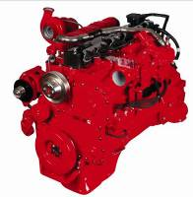
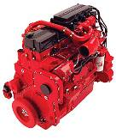
Technology
What is the Same?
Major Engine Components
  Block, crankshaft, main bearing, piston rods, EGR
  Over 80% parts commonality
500 hour Maintenance Interval
Parts and Service
  Global Cummins Distributor Network
320, 300, 280, 260 and 250 HP ratings
Compatible with Cummins Diagnostic tools
  Insite
  Quickserve online
Manufactured in Cummins Engine Plant, North Carolina

Slide 5

Technology
What is Different?
Cylinder head
  2 valve vs. 4 valve (diesel)
Ignition
  Spark Ignition (SI) vs. Compression (diesel)
Fuel System
  Intake manifold vs. Common rail injection (diesel)
Aftertreatment
  3 way catalyst vs. Particulate Filter + Selective Catalytic Reduction (diesel)
Maintenance Cost
  Incremental cost of maintenance related to ignition and overhead valve adjustments adds up to $0.03 per mile ($0.02 per km) to ISL G
Fuel Cost
  Natural gas costs less than diesel
  Fuel cost per mile (KM) is lower.
Lubricating Oil
  Natural gas engines require a specific oil that meets Cummins specification CES 20074
Noise
  Natural gas engines are up to 10db quieter at idle
Compression Ratio
  ISL G is 12:1 compression
  Lower power density

Slide 6
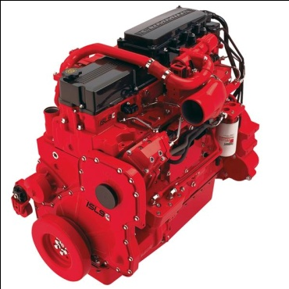
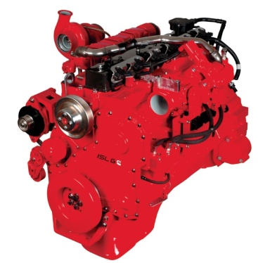
Estimated System Weight ~ 60 Gallons Fuel
CNG – 1,000 lbs more
LNG – 300 lbs more
System Weights | ISL9 Diesel | ISL G Natural Gas
Engine | 1,695 lbs | 1,625 lbs
Aftertreatment | 400 lbs | 100 lbs
Fuel Tanks
- Diesel (60 Gal) | 100 lbs (600 lbs Full)
- CNG (60 DGE) |  | 1,600 lbs (2,000 lbs Full)
- LNG (68 DGE) |  | 815 lbs (1,288 lbs Full)
Total Weight (Full) | 2,695 lbs | CNG - 3,725 lb LNG - 3.013 lb

Slide 7
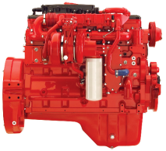



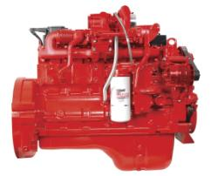

2010 Engines Aftertreatment Comparison
SCR Catalyst
Particulate Filter
Heated
Urea Tank
Urea Dosing Control Unit
ECM
Cummins TWC

Slide 8

Tough California Emissions Standards and Cummins Westport Engines
California Air Resources Board - Executive Order Shows Emissions Results
ISL G is under 2010 NOx and PM regulations
 | NMHC |  | NOx |  | CO |  | PM
 | FTP | EURO | FTP | EURO | FTP | EURO | FTP | EURO
STD | 0.14 | 0.14 | 0.2 | 0.2 | 15.5 | 15.5 | 0.01 | 0.01
CERT | 0.13 | 0.04 | 0.13 | 0.01 | 1.2 | 0.4 | 0.002 | 0.000
FTP: Federal Test Procedure [ transient and steady state ]
EURO: Euro III European Steady-State Cycle
STD: standard or emissions test cap
CERT: certification level
Further Reductions are Being Explored
  Sub Ambient
  “Zero” Emissions

Slide 9
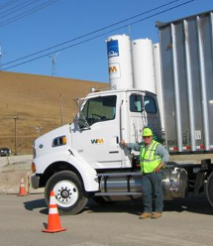
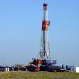


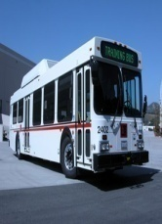
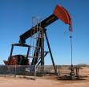
Internal Combustion Engines & Green House Gases (GHG)
Biomethane Impact
Bowerman Landfill
Extraction
Processing
Transportation and storage
End user
Total
WM Altamont
Natural Gas
115 g/km
49.5 g/km
53.9 g/km
1,183.9 g/km
1,402.4 g/km
Diesel
268.8g/km
179.5 g/km
9.7 g/km
1,353.7g/km
1,811.7 g/km
Bio Fuel improves GHG impact
Biomethane: 75-200% reduction
Source:http://www.nsca.org.uk/assets/biogas_ as_transport_fuel_june06.pdf
Compressed Natural Gas - 22% GHG reduction
Notes:
Note the impact that Biomethane has on the GHG’s.

Slide 10
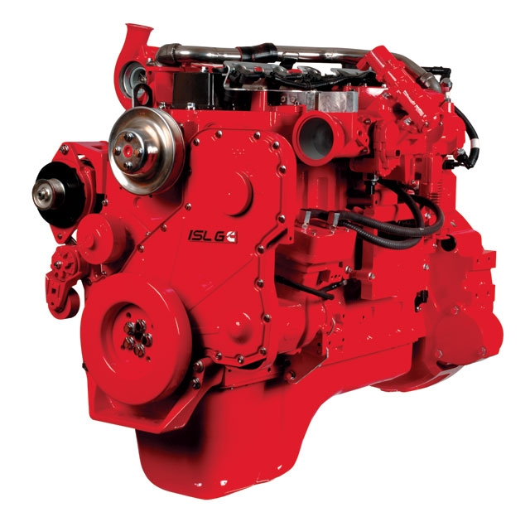
Our initial assessment indicates the current ISL G is compliant for all 2014 GHG standards except HHD Tractor Trailer.
The ISL G meets vocational standards (incl. Urban Bus) in current form.
To meet Tractor Trailer standards, the ISL G may need Closed Crankcase Ventilation (CCV) and changes to catalyst coating formulation.
Neither change would be significant. If required for Tractor Trailer, would likely standardize across all applications.
MHD = Medium Heavy Duty
HHD = Heavy Heavy Duty

Slide 11
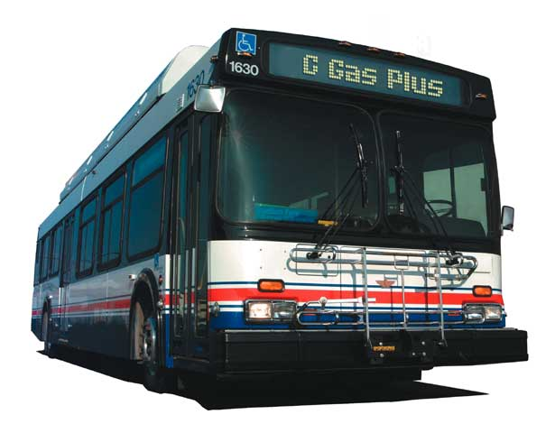
Top North America CNG Transit Fleets
150
1500
300
400
600
NYCT
L A
BOSTON
WASHINGTON
PHOENIX
500
400
300
250
250
ORANGE COUNTY
SAN DIEGO
SACRAMENTO
SAN BERNADINO
TACOMA
Fort Worth, TX
over
8,000
engines in service
LA, CA — DOT
Santa Clara, CA
Toronto, ON
LA, CA — Foothill
Hamilton, ON
Atlanta, GA
Las Vegas, NV
Vancouver, BC
St. Louis, MO
Baton Rouge, LA
Seattle, WA
Corpus Christi, TX
San Antonio, TX
Fresno, CA
Santa Monica, CA
Ocean Side, CA
Culver City, CA
Albuquerque, NM
Medford, OR
Montgomery County, MD
Port Huron, MI
Long Island, NY
Salem, OR
Cape Cod, MA

Slide 12
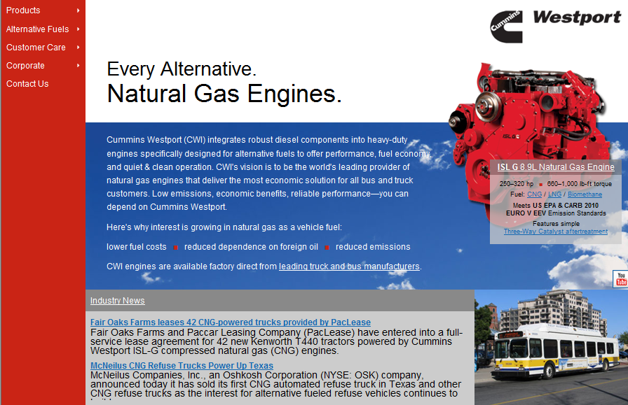
www.cumminswestport.com

