Slide 1
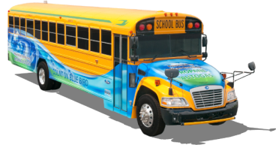
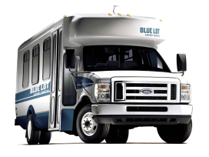
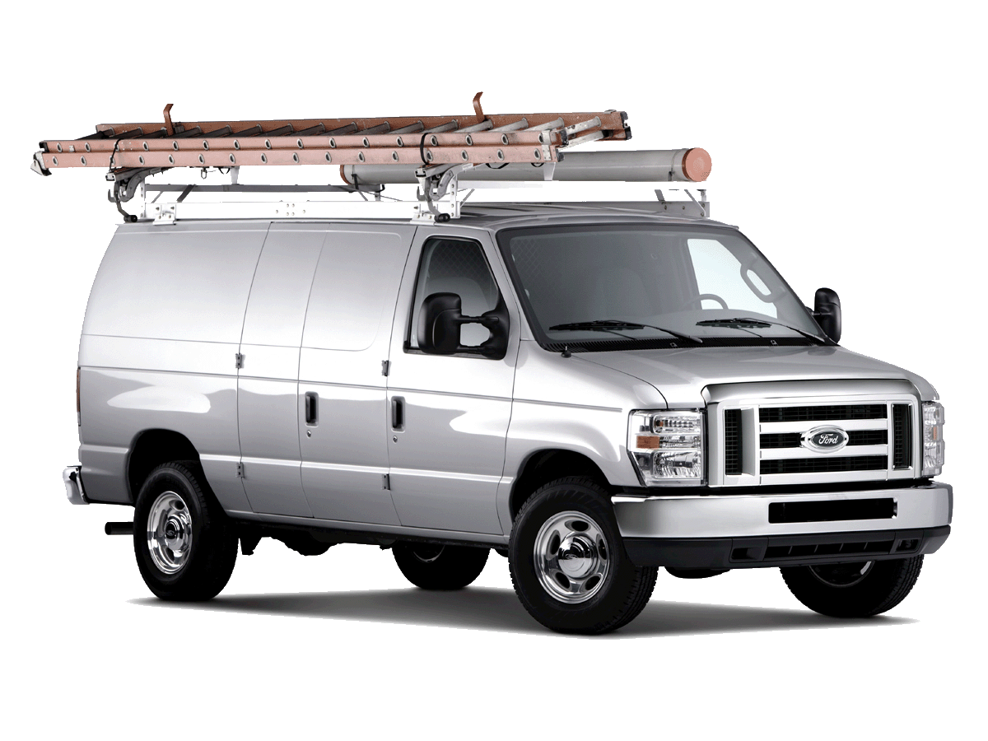
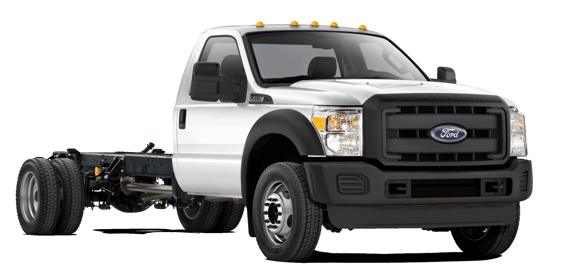
LIQUID PROPANE AUTOGAS:
Product Introduction & Overview
09.11.12

Slide 2
ROUSH CleanTech
Company Background & History

Slide 3
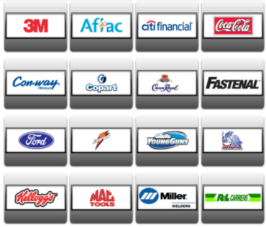
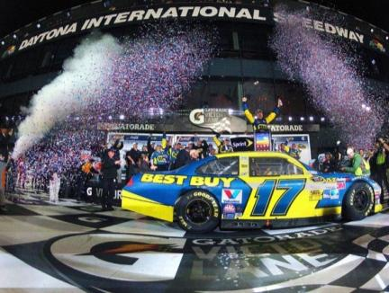
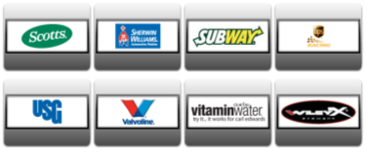
What are We Best Known For?
Largest and most successful team in motorsports history
Motorsports Management
Licensing
Retail Operations

Slide 4
Corporate Overview
Corporate Wheel of Capability

Slide 5
Corporate Overview
Transportation
Ford
Defense
Navistar Defense
Entertainment
Chrysler
GM
Toyota
Honda
Hyundai
Isuzu
Volkswagon
EcoMotors
VPG
Navistar
Bluebird
BAE Systems
Hardwire
Astradyne
AM General
General Dynamics
Textron
FAAC
US Army/TARDEC
Oskosh Defense
Disney
Universal Studios Orlando
Hong Kong Disneyland
Disney California Adventure
Universal Studios Singapore
The Henry Ford
Life Sciences
GE Healthcare
VWR
UPG
Stryker
Covidien
SAIC
Motorsports
Ford
3M
Aflac
Crown Royal
UPS
Scotts
Kellogg
Valvoline
Coca-cola
Fastenal
Disneyland Paris
Universal Studios
DeGroot
Merck
Terumo
Invacare
Somanetics
Genetix

Slide 6
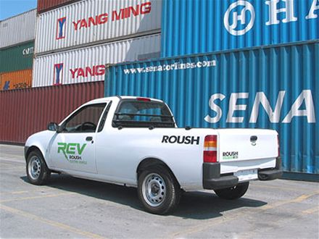
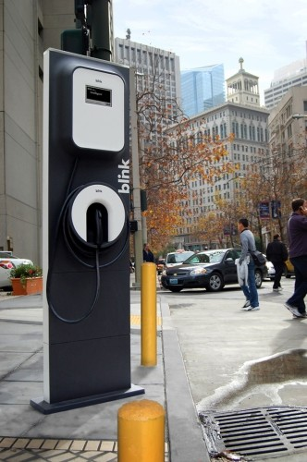
Alt Fuels Experience…

Slide 7
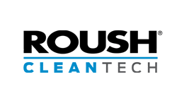
ROUSH Enterprises Brand Portfolio
ROUSH CleanTech
Dedicated to developing quality alternative fuel solutions.
Propane autogas focus.
EPA and CARB certification ability.
Platform customization to suit customer needs.
Reduces operating costs, carbon footprint.
OEM support through Ford and BPN dealers.
Creating opportunities for partner companies.
Using American fuel and American technology.

Slide 8
Factors for Alt Fuel Analysis
Economics
Energy Independence
Environmental Responsibility

Slide 9
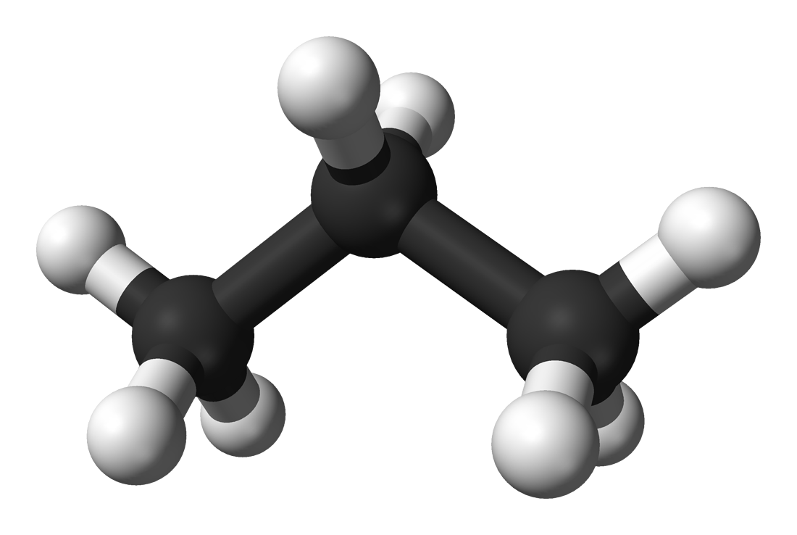
Why Propane Autogas?
Clean
24% reduction in Greenhouse Gas (GHG) emissions.
20% reduction in Nitrogen Oxide (NOx) emissions.
60% reduction in Carbon Monoxide (CO) emissions.
Domestic
90% of propane used in U.S. comes from U.S.
7% of propane used in U.S. comes from Canada.
Abundant
Most refueling infrastructure of any alternative fuel.
Major natural gas shale found in northeast U.S.
Powers over 17 million vehicles worldwide.
Safe
Low pressure (~ 200 psig).
Narrow flammability range.
Fuel tanks are 20 times more puncture resistant than gasoline.
Propane Molecule
(C₃H₈)

Slide 10
Product overview:
Pickups | Vans & Wagons | Cutaway Vans
Chassis Cab | School Bus

Slide 11
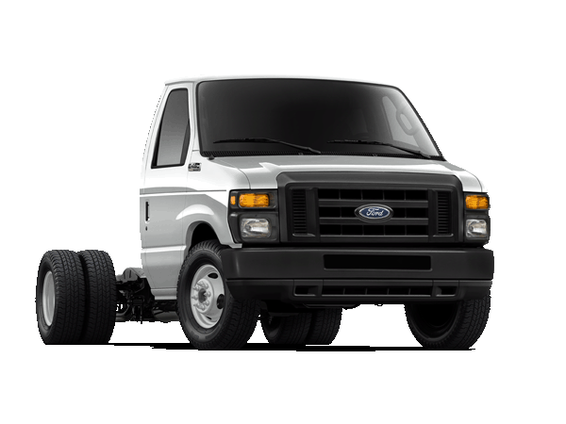
Product Overview – Vans & Wagons
Ford E-450 DRW Cutaway
Model Years: 2009 – 2013
Engine Size: 6.8L V10 (2V)
Applications: 156” or 176” wheelbase
Stretched Chassis
5-speed auto transmission
Tank Size: Aft-Axle: 41 usable gallons
Technical Specs: EPA and CARB approved
GVWR: < 14,500 lbs.
Requires “91G” gaseous fuels prep package.
Order Availability: Ford Ship Through
Conversion Kits

Slide 12
E-450 Cutaway Aft-Axle Fuel Tank
FRPCM
The Fuel Rail Pressure Control
Module ensures consistent vehicle
performance and power on-demand.
Fuel Tank
The liquid propane autogas fuel tank
meets all ASME certification standards,
is made of ¼ inch thick steel, and is
built and assembled in the USA.
Fuel Rail
ROUSH CleanTech’s signature
blue anodized aluminum fuel
rail is designed to operate
under varying temperatures
of liquid propane
Fuel Fill
Industry-standard valve designed to
allow for safe passage of liquid pro-
pane into the vehicle. Includes a
check valve to prevent fuel leaks.
Fuel Injectors
Special fuel injectors are used
to inject liquid propane into the
cylinders for ignition.
Fuel Lines
Made of high-durability stainless
steel to handle varying temperatures
and pressures. They are designed to
route through the factory line locations.

Slide 13
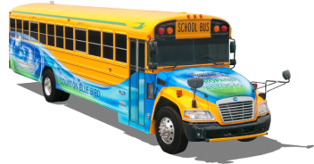
Product Overview – School Bus
Blue Bird Vision
Model Years: 2012 - Newer
Engine Size: 6.8L V10 (3V)
Applications: Blue Bird Vision
Blue Bird MFSAB / Activity Bus
Tank Sizes: 67 usable gallons
Technical Specs: EPA and CARB Approved
Up to 77 Passengers
GVWR: 33,000 lbs.
Order Availability: Blue Bird Dealers

Slide 14
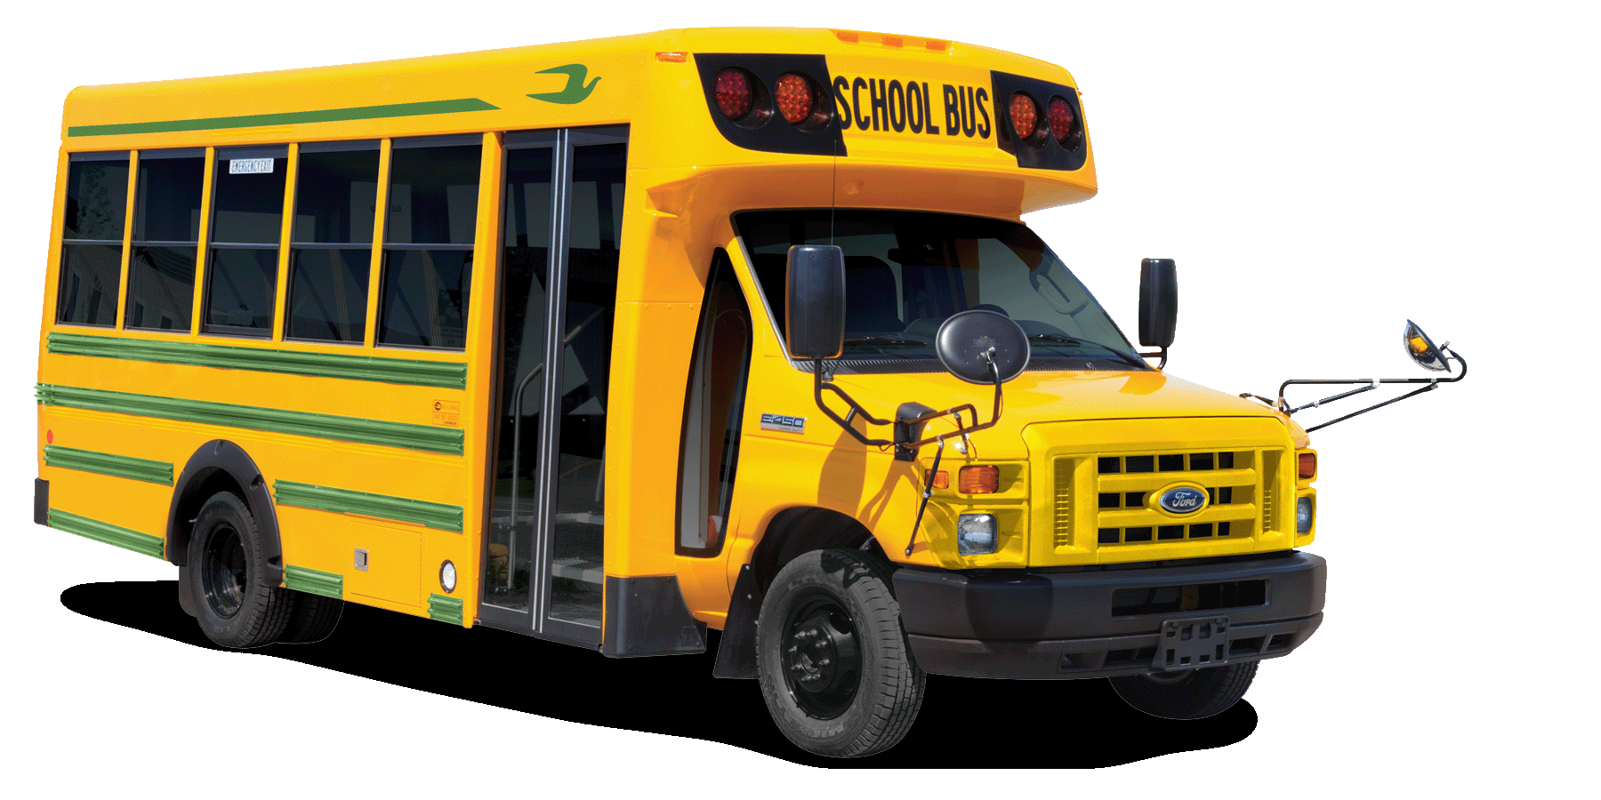
Product Overview – School Bus
Ford E-450 DRW Cutaway
Model Years: 2009 – 2012
Engine Size: 6.8L V10
Applications: Dual rear wheel cutaway
5-speed auto transmission
Tank Sizes: Aft-Axle: 41 usable gallons
Technical Specs: EPA and CARB Approved
Up to 30 Passengers
GVWR: 14,500 lbs.
Order Availability: Blue Bird Dealers

Slide 15
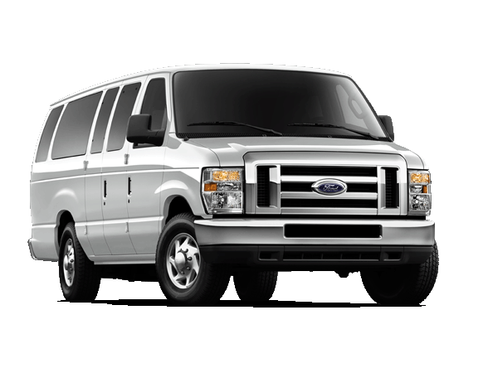
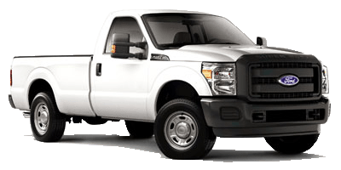
ROUSH CleanTech Products
Ford E-150 / E-250 / E-350 cargo and passenger vans
5.4L V8 engine
Ford F-250 / F-350 pickup trucks and chassis cabs
6.2L V8 engine

Slide 16
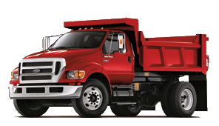
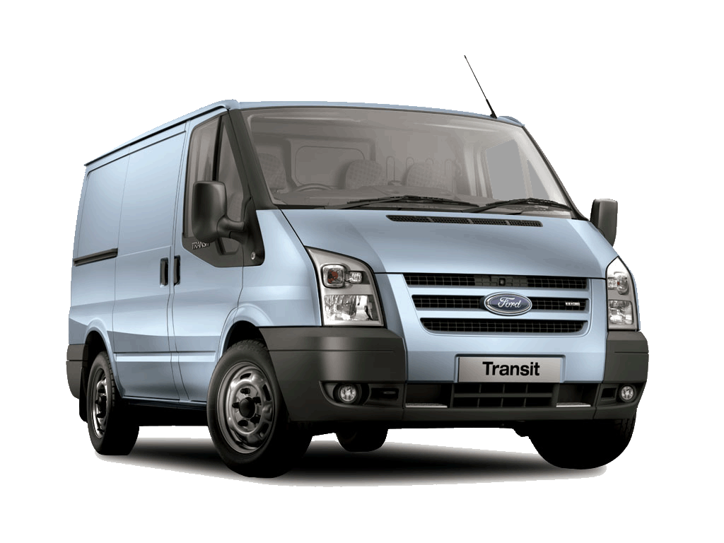
Coming Soon
Ford F-650
6.8L V10 (3V)
Ford F-450 / F-550
6.8L V10 (3V)
Ford Transit
3.7L V6
Ford F-650
Ford F-450 / F-550
Ford Transit

Slide 17
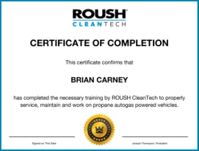
Service and Warranty Program
The ROUSH CleanTech Service Program consists of multiple components to assist Dealers and Service Centers:
Service Center Agreement (Basic Requirements)
Interactive Web-Based Training Program
Service and Diagnostic Manuals
Technical Information Videos
Technical Phone Support
Warranty Claims Resolution Process
Notes:
The ROUSH CleanTech Service and Training Program consists of multiple components to assist customers, dealers and service centers in the overall vehicle service and repair process.

Slide 18
Web-Based Training Program
This program offers two focused courses:
Service Technician Course
Propane as an Autogas
Propane Autogas Fuel System Overview
System Diagnostics and Troubleshooting
Basic Warranty Information
Service Manager/Advisor Course
Propane as an Autogas
Propane Autogas Fuel System Overview
Detailed Warranty Process

Slide 19
Return on investment
A Positive Return, Even Without
Government Incentives

Slide 20
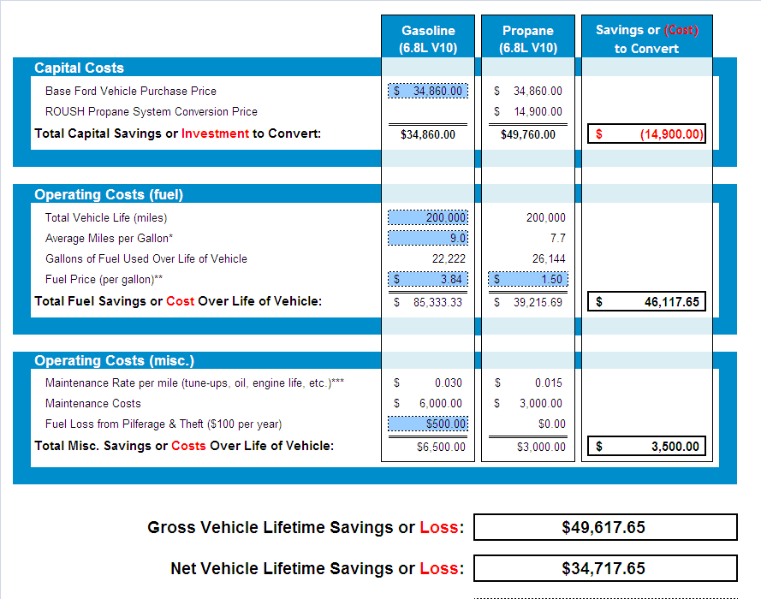
Savings Calculator
2012 Ford E-450 Cutaway

Slide 21
Savings Calculator
2012 Ford E-450 Cutaway

Slide 22
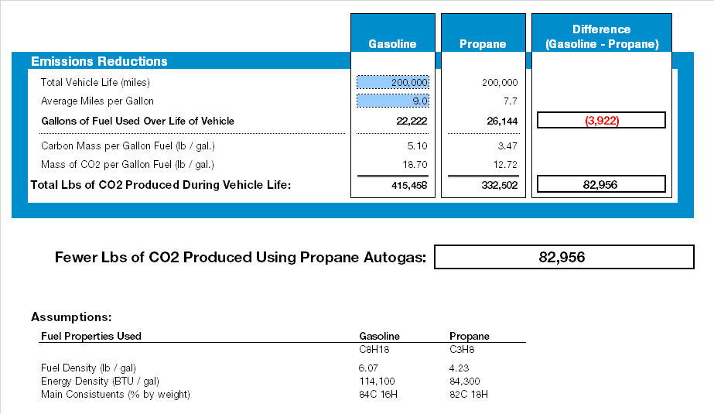
Emissions Calculator
2012 Ford E-450 Cutaway

Slide 23
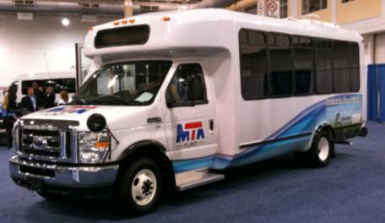
Flint Mass Transit Authority
Industry: Para-transit
Location: Flint, MI
Current Vehicles: 10 E-450 shuttle buses
Future Vehicles: 60 E-450 shuttle buses
By the Numbers:
$1.26 per gallon for propane autogas for the
next twelve months.
83,000 fewer pounds of CO₂ per shuttle bus.
“Propane autogas is a good fit for us. We anticipate purchasing propane fuel for half the price of diesel. It will reduce our dependency on diesel and drive down our cost of operation.”
– Edgar Benning, general manager, Flint Mass Transit Authority

Slide 24
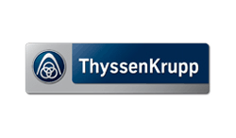
Customer Adoption

Slide 25
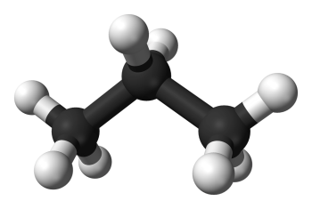
Success in the U.S. Because…
Price of propane autogas
40% less expensive than gasoline.
Emissions reduction
24% reduction in Greenhouse Gas (GHG) emissions.
20% reduction in Nitrogen Oxide (NOx) emissions.
60% reduction in Carbon Monoxide (CO) emissions.
National security
Decreases dependence on foreign oil.
97% of U.S. propane is from North America.
Propane Molecule
(C₃H₈)

Slide 26
Contact us:
800.59.ROUSH
ROUSHcleantech.com
Todd Mouw
Vice President, Sales & Marketing
734.466.6522
Todd.Mouw@roush.com

