Slide 1
Major Challenges Confronting Equipment and Maintenance Fleet Budgets and how to solve them
Green Fleet 2010
Mark Dice & Keven Birck
Triad Lubrication LLC

Slide 2
Current Economy

Slide 3
Do you see fuel costs going down?

Slide 4
Equipment Turnover
Budget cuts are requiring that equipment turnover be extended
What would it mean to get another year, two or three years out of YOUR Equipment?

Slide 5
By Utilizing the Kleenoil On-Board Oil Recycling System
You will Run All your equipment on Clean Oil All the Time!
Remove All particles to 1 micron in size
Remove 99.95% of All water
Maximize life of engine & hydraulic equipment

Slide 7
Founded in 1978 (worldwide distribution)
ISO 9001:2000 rated
Power-up can offer your fleet the following..
-boundary lubrication instead of metal
conditioners (90% of wear occurs at startup)
- save up to 15% on fuel costs
- lower hydraulic operating temperatures
- increase component life up to 2.5 times
- prevents major breakdowns and repairs
- provide long term protection

Slide 8
Cat C15
H&R Trucking
Roswell, NM
Delivering Feed to Dairy Farms

Slide 9
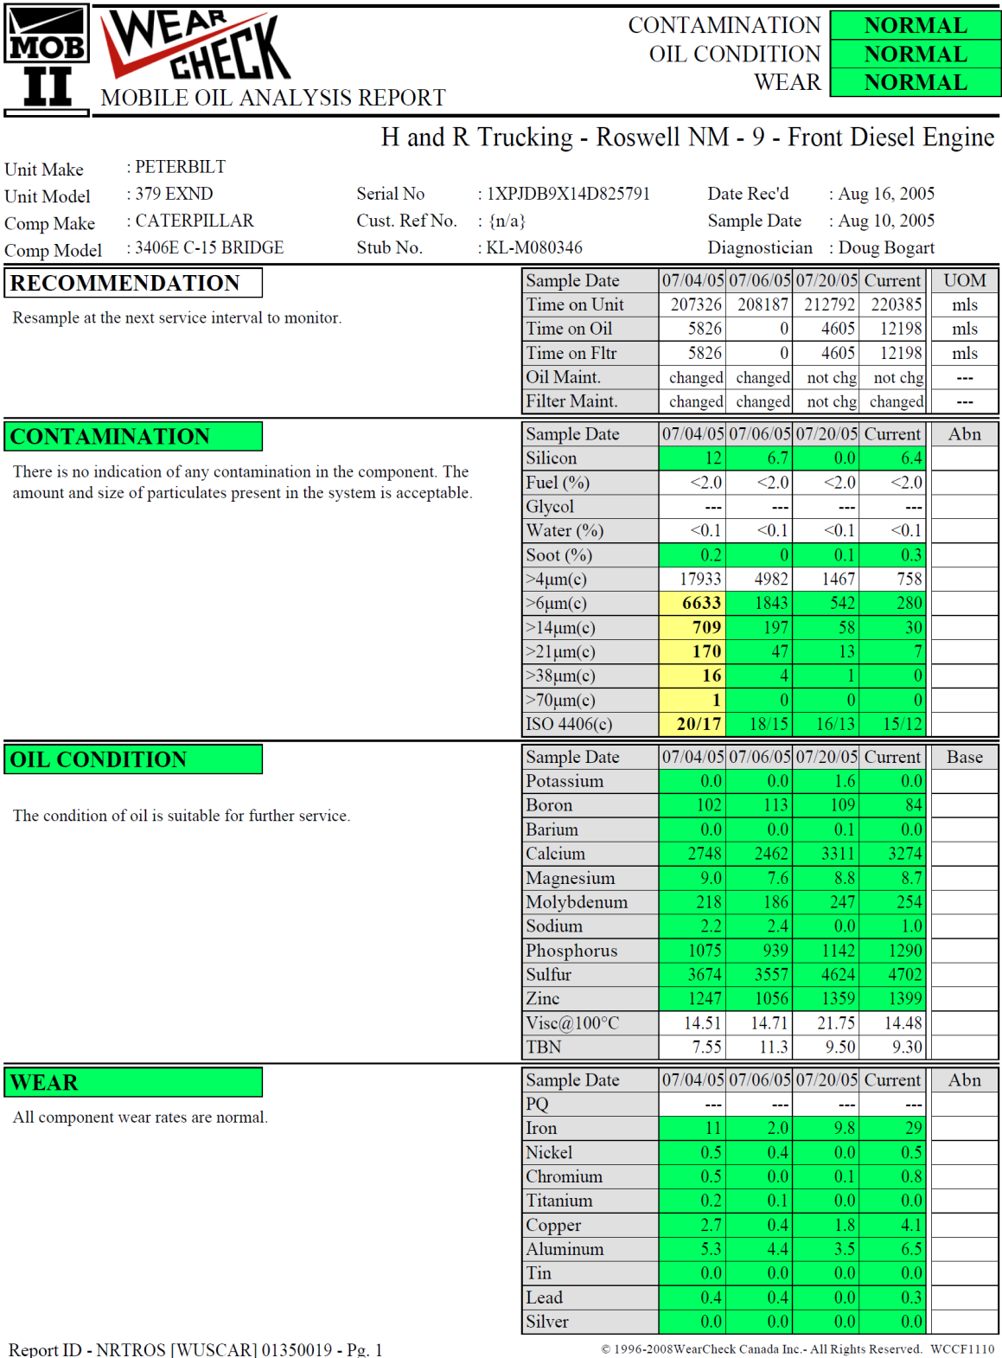

Slide 10
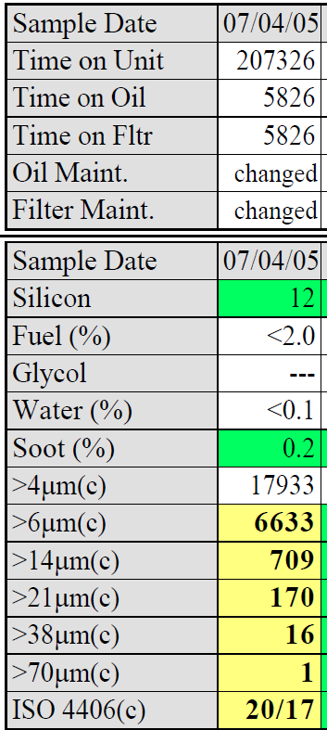
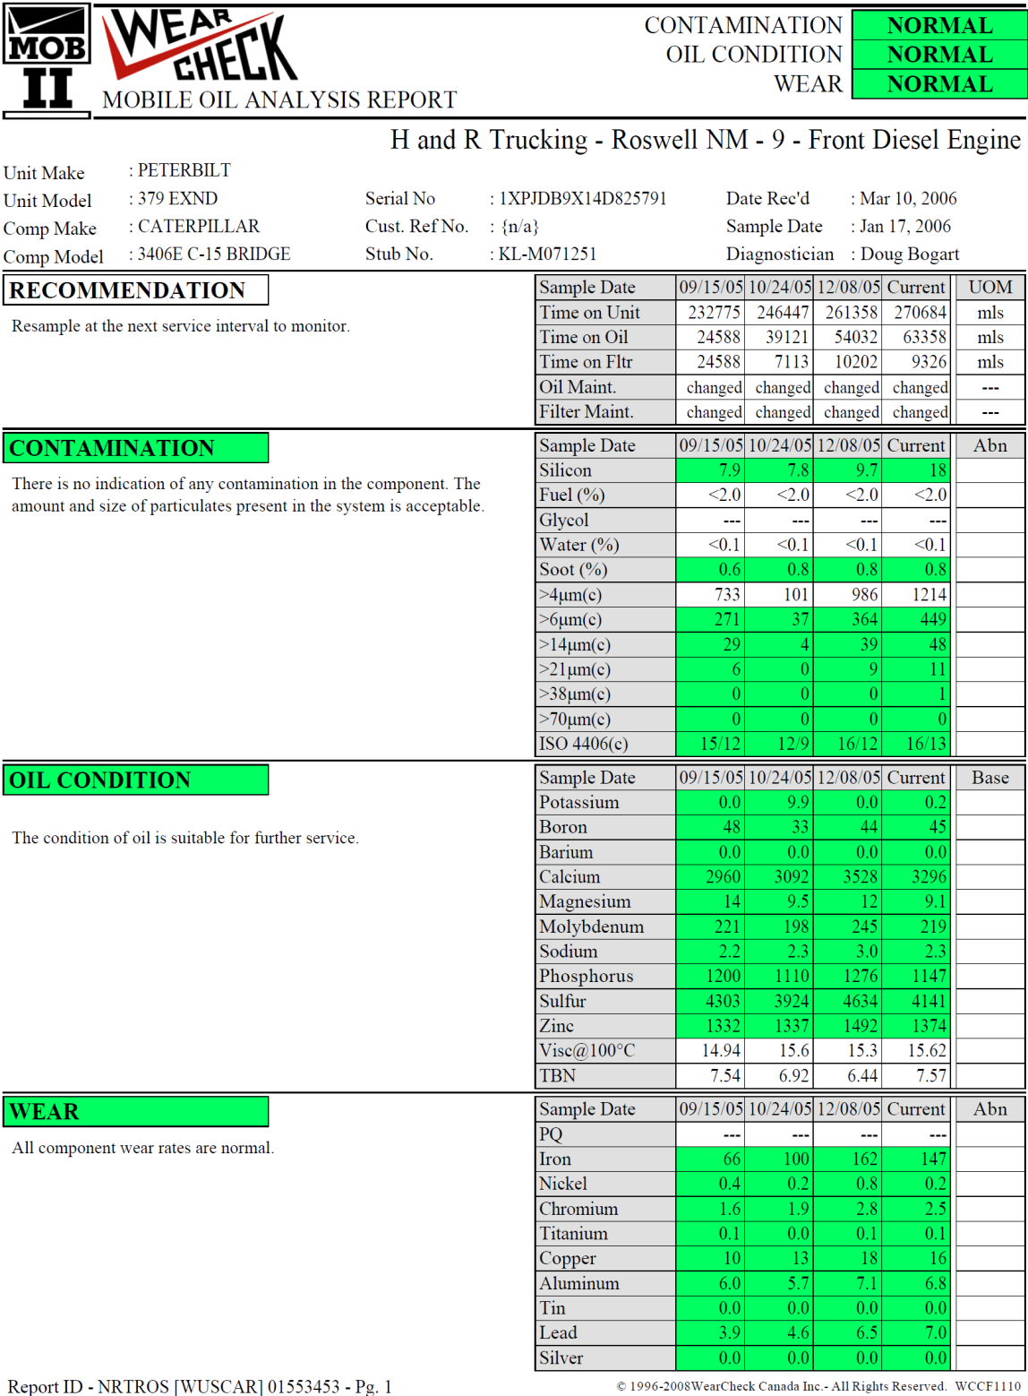

Slide 11
The Extension by Reducing ISO Codes

Slide 12
City of Las Cruces 2004 AutoCar

Slide 13
City of Las Cruces Morbark Wood Chipper

Slide 14
New Mexico Dept. of Transportation 10 Yd. Dump

Slide 15
City of Artesia Impac Side loader

Slide 16
City of Artesia Yard Tug

Slide 17
City of Artesia Grizzly Crane

Slide 18
City of Artesia Volvo Loader

Slide 19
Chaves County Flood Control Cat 140H

Slide 20
Chaves County Flood Control XL 4200

Slide 21
City of Ruidoso Cat 140H Motor Grader

Slide 22
City of Casa Grande

Slide 23
Our proposal
Pick a piece/s of equipment out of your fleet as a test/s
Install a Kleenoil system on it. Utilize oil analysis to track the results
If your not satisfied Triad Lubrication will refund your money
100% money back guarantee

