Slide 1
Propane Education
&
Research Council
Greg Zilberfarb
Consultant
Propane Education & Research Council

Slide 2
Propane Industry
Propane Education and Research Council PERC Promotes safe, efficient use of odorized propane through investments in research, safety and consumer initiatives (created 1998)
National Propane Gas Association
Membership is comprised of small businesses and large corporations engaged in all segments of the industry from retail marketing and appliances to manufacturers of equipment

Slide 3
Production
50 percent of the propane used in the USA comes from raw natural gas. (Raw natural gas is about 90 percent methane, 5 percent propane and 5 percent other gases.)
40 percent comes from petroleum during the refining process. (Propane vapors separated from gasoline liquid.)
7 percent from Canada
3 percent imported

Slide 4
Products and solutions

Slide 5
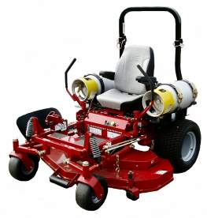
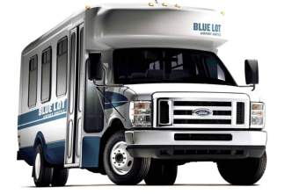
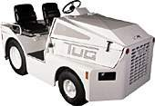
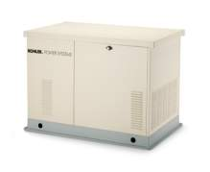
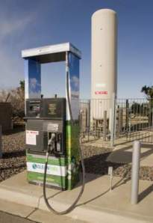
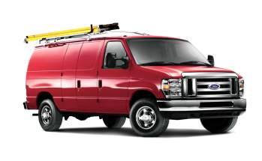
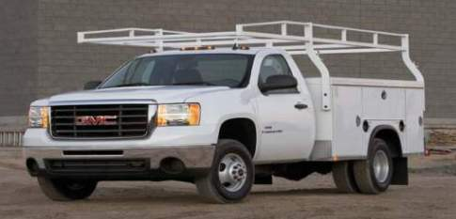
propane-a total solution

Slide 6
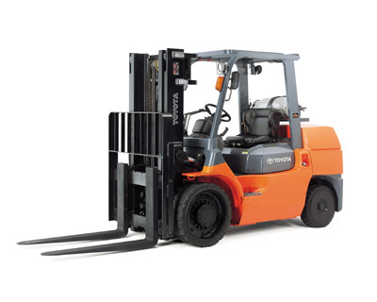
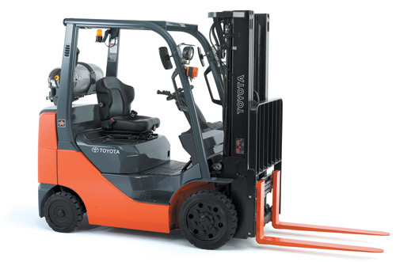
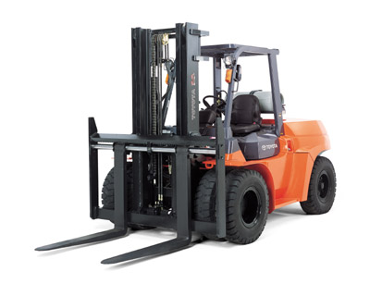
PROPANE FORKLIFTS

Slide 7

Propane Trimmer
Available at Sears, Home Depot and Ace Hardware

Slide 8



Lehr eco series
Copyright © 2008, LEHR, Inc.
GoLEHR.com

Slide 9














PROPANE COMMERCIAL MOWING OEMs

Slide 10
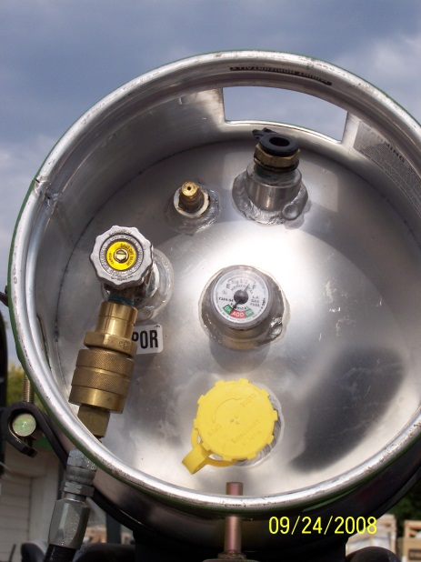
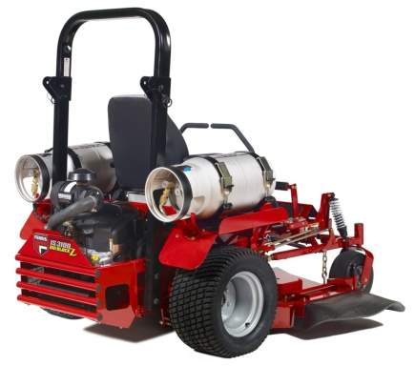
Propane mower advantages
Briggs & Stratton
BIG BLOCK™
32 HP Propane engine
delivers a minimum
of 30% lower
harmful emissions.
Not a converted gas engine.
Engine has been EPA
and CARB certified.

Slide 11


PROPANE SCHOOL BUSES
Notes:
11
11

Slide 12


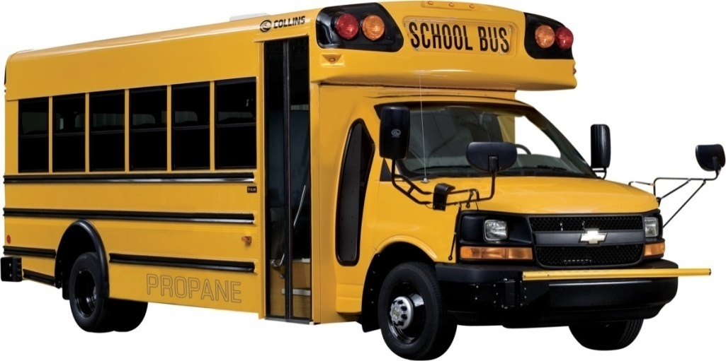


GM Cutaway Chassis
COLLINS BUS CORPORATION
6.0L V8 Gasoline engine
12,300 & 14,200# GVW
139” or 159” Wheelbase
6 Speed automatic transmission w/od
145 Amp alternator
40.5 Gallon propane tank
Estimated fuel range 300 miles

Slide 13




Blue Bird Vision Type-C School Bus Propane-Powered

Slide 14
Product Development Strategy
Utilize the highest volume Type-C school bus and successfully have it operate on propane instead of diesel
Must remain designed and engineered to the same exacting standards and meet all Federal Motor Vehicle Safety Standards
Become the lowest incremental cost alternative fuel powered large school bus
Notes:
Our development strategy was to take our most trusted and popular conventional Type C school & activity bus and have it operate on propane instead of diesel yet remain designed and engineered to the same exacting standards

Slide 15
Product Development Strategy
The result: Only fully integrated and school purpose-built chassis OEM propane-powered large school bus
Safe, Affordable Green Transportation
  Already the lowest cost alternative fuel powered large school bus with a $13,761 MSRP differential to 2009 Diesel buses, with 2010 diesel emission treatment added to buses this will be reduced further to more like a $7,500 premium.
Notes:
Our development strategy was to take our most trusted and popular conventional Type C school & activity bus and have it operate on propane instead of diesel yet remain designed and engineered to the same exacting standards

Slide 16
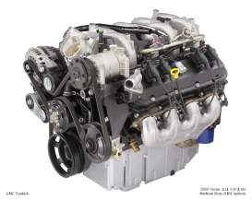
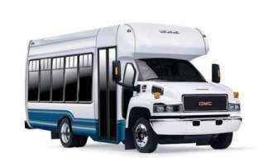
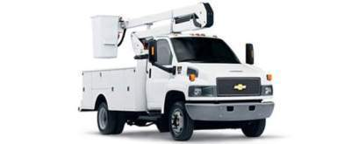
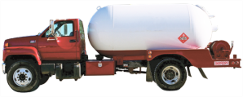

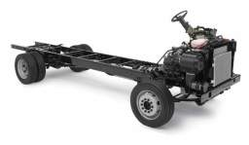
Over 1800 CleanFUEL USA/gm vortec 8.1l lpi in service

Slide 17
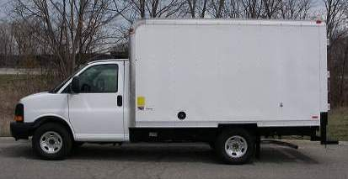

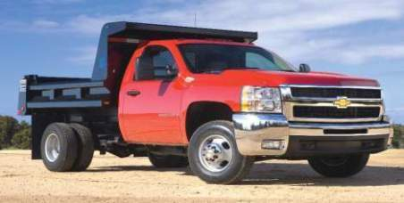
Cleanfuel usa/Gm 6.0l cutaway van c2500/3500 hd chassis cab and type a collins school bus

Slide 18
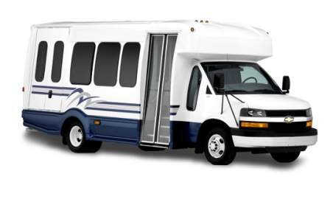
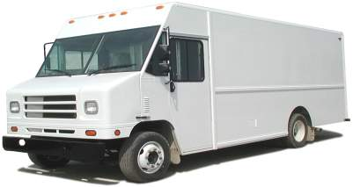
Cleanfuel usa/Gm 6.0l g4500 cutaway van/workhorse w42
Walk in Van Applications

Slide 19
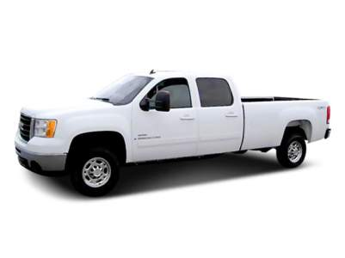
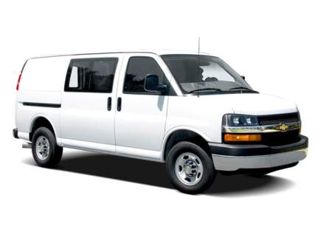
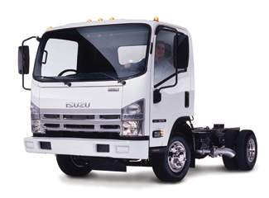
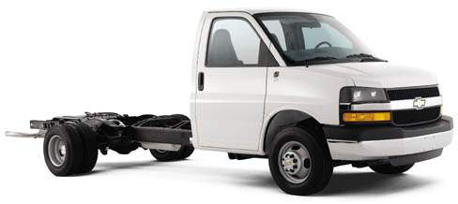
CLEANFUEL USA GM 6.0L ENGINE OPTIONS

Slide 20
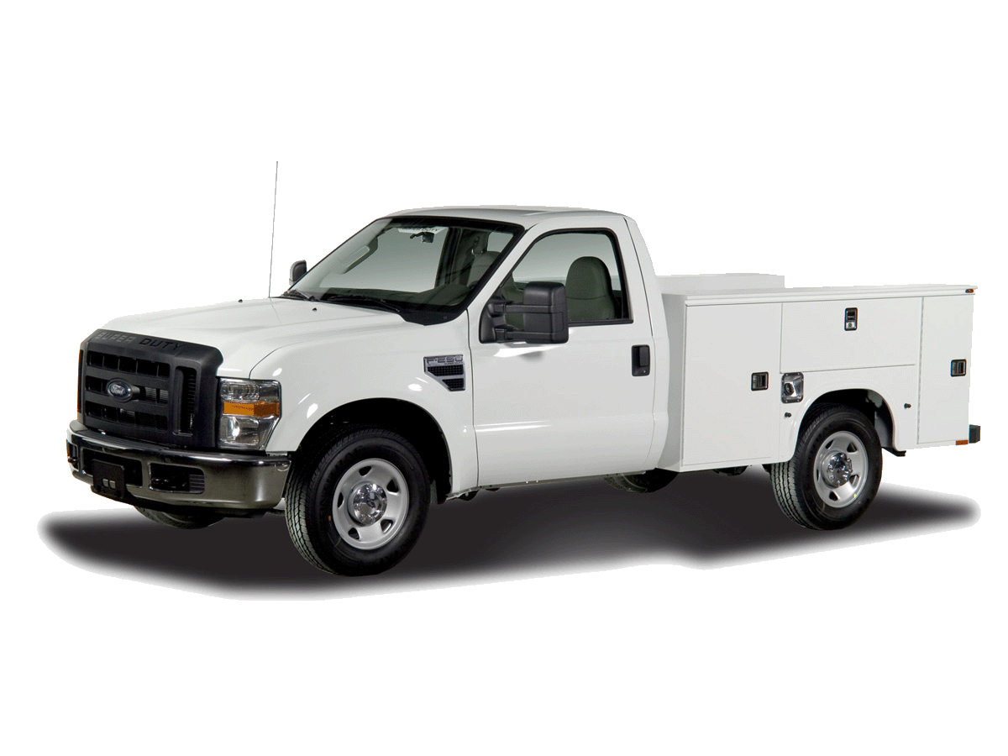
Product Overview - Pickups
Ford F-250 / F-350
Model Years: 2009 – 2010
Engine Size: 5.4L V8 (3V)
Applications: All Bed Lengths
All Cab except Chassis Cab
All Axle configurations
Tank Sizes: In-Bed – 55 gallons
Under-Bed - 23 gallons
Ordering: Ford Ship Through
Conversion Kits
Certification: EPA
CARB

Slide 21
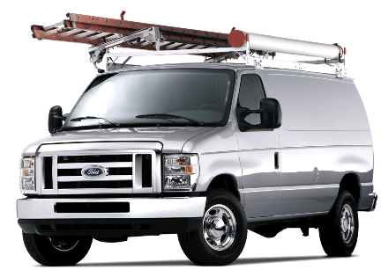
Product Overview – Vans & Wagons
Ford E-150 / E-250 / E-350
Model Years: 2009 – 2011
Engine Size: 5.4L V8 (2V)
Applications: All Cargo configurations
All Passenger configurations
Single Rear-Wheel Cutaway
Tank Sizes: Under-Floor – 25 gallons
Ordering: Ford Ship Through
Conversion Kits
Certification: EPA
CARB (pending)

Slide 22
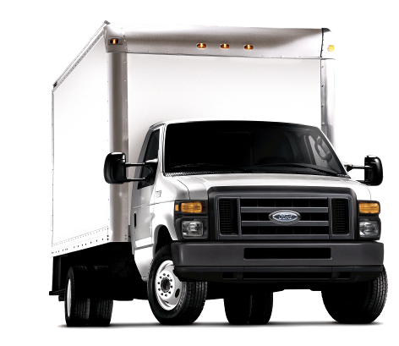
Product Overview – Cutaway Vans
Ford E-450 Cutaway
Model Years: 2009 – 2011
Engine Size: 6.8L V10 (2V)
Applications: Dual Rear-Wheel Cutaway
5-Speed Auto Transmission
Tank Sizes: Under-Floor – 43 gallons
Ordering: Ford Ship Through
Conversion Kits
Timing: September 2010

Slide 23
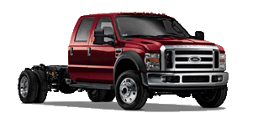
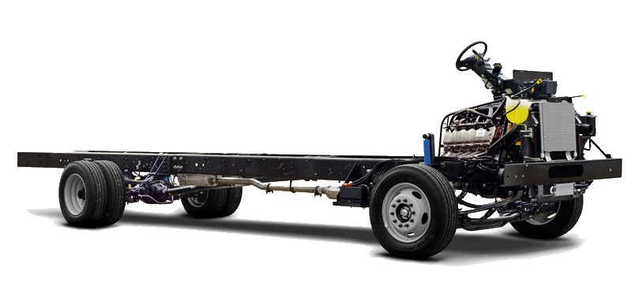
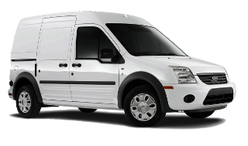
Future Product Development
Ford F-450 / F-550
  6.8L V10 (3V)
Ford F-650 / F-750
  6.8L V10 (3V)
Ford F-59 / F-53 Strip Chassis
  6.8L V10 (3V)
Ford F-250 / F-350
6.2L V8 (3V)
Ford Transit Connect
Ford F-150
Ford F-550
Ford F-59 Strip Chassis
Ford Transit Connect

Slide 24

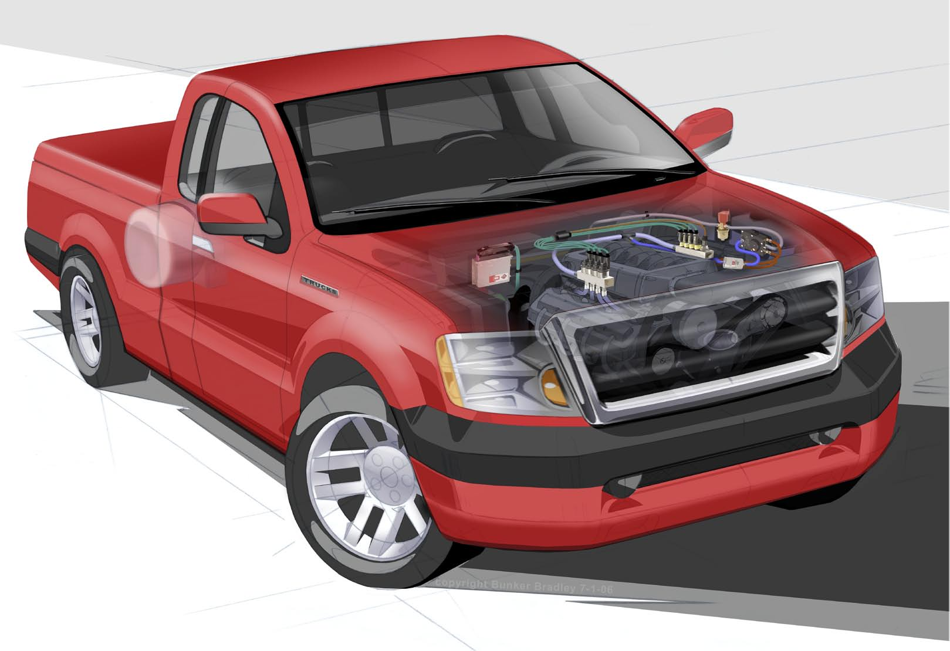
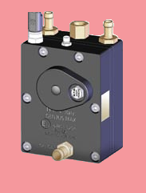
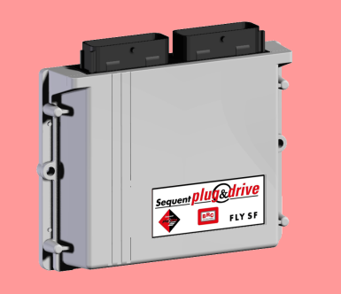
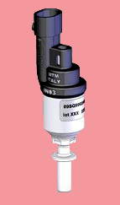
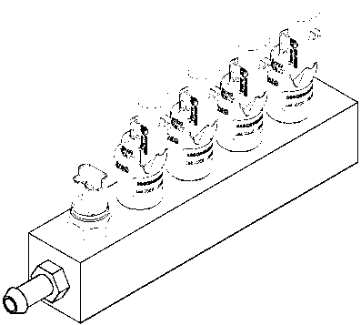
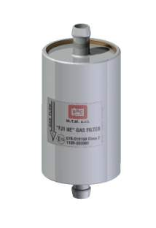
SEQUENT SYSTEM
LPG Reducer
Gaseous ECU
Injector & Rail Assembly
Vapor Filter (LPG)

Slide 25
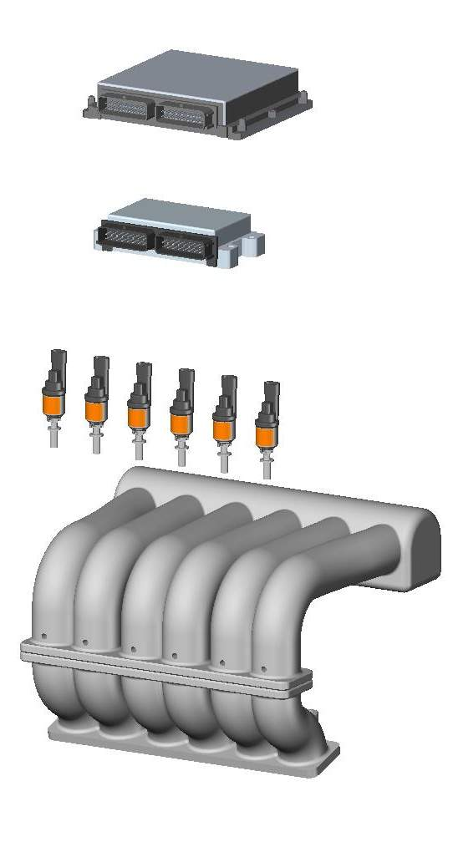

FUEL CHANGEOVER
THE OEM INJECTORS ARE SHUT DOWN BY THE SEQUENT PLUG & DRIVE ECU
CONDITIONS THAT ALLOW CHANGEOVER:
Temperature
(engine coolant @ the alt fuel regulator)
Time After Engine Start
SPECIFICALLY DESIGNED FOR BI-FUEL APPLICATIONS
Sequential Changeover

Slide 26



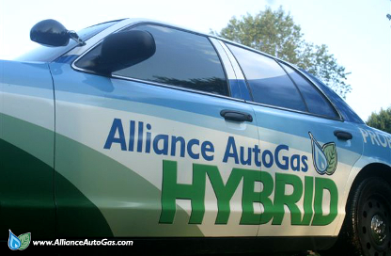
Alliance autogas
Alliance AutoGas uses the Prins Vapor Sequential Injection System:
  Used widely in Europe and Asia
  Starts on gasoline, immediately switches to AutoGas
  Can switch back to gasoline if an AutoGas filling station cannot be reached.
  DOT-approved fuel tanks, multiple mounting options
Alliance AutoGas founding partner American Alternative Fuels (AAF) is the exclusive North American Distributor of the Prins System
Alliance AutoGas Certified Conversion Technicians require just 10 man-hours, on average, to convert a vehicle from gasoline to propane AutoGas using the Prins VSI system
26

Slide 27


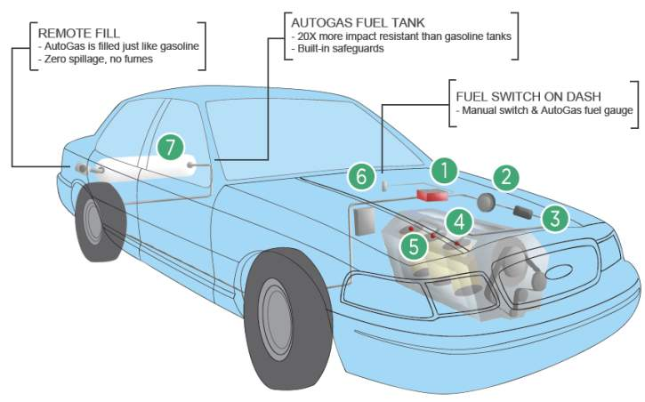





Alliance autogas systems
The AAF – Prins VSI System
(VSI = Vapor Sequential Injection)
VSI ECM
REDUCER
FILTER UNIT
INJECTOR RAIL
OEM INJECTOR
FUEL SELECTOR SWITCH
TANK
Notes:
Outline the Conversion process, how it works

Slide 28
FUELING

Slide 29
Propane is economical
As an engine fuel it costs ~30-50 percent less than gasoline
Pricing tends to be better in propane producing states like Texas and Louisiana
Propane is ~ 106 octane
Same HP and torque as gasoline vehicles
The Fine Print
Propane is 91,600 btus
New technology provides better efficiency resulting in ~10 percent less mileage

Slide 30
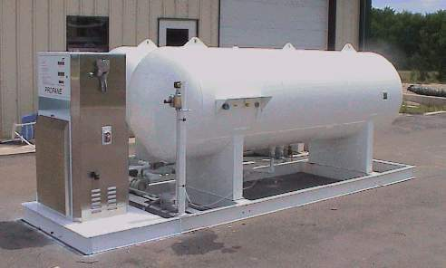
Economical
Installing a propane station is the least expensive alternative even as compared to gasoline or diesel stations
  4-7 HP electric motor
  No ground water contamination
  Non toxic
  No costly EPA monitoring system
  Low pressure, 100-300 psig
  Low noise
  2000 gallon skid mounted system with basic dispenser for ~ $22,000…installed!

Slide 31
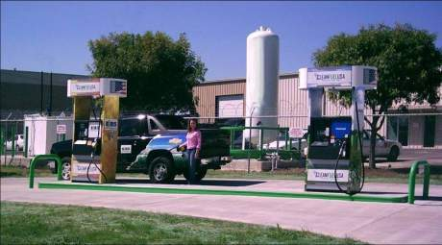
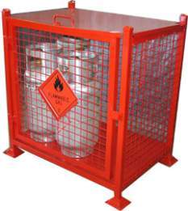
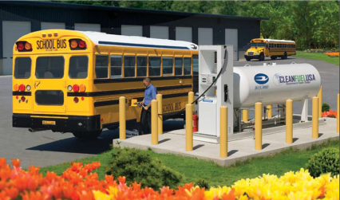
Fueling Infrastructure Options

Slide 32
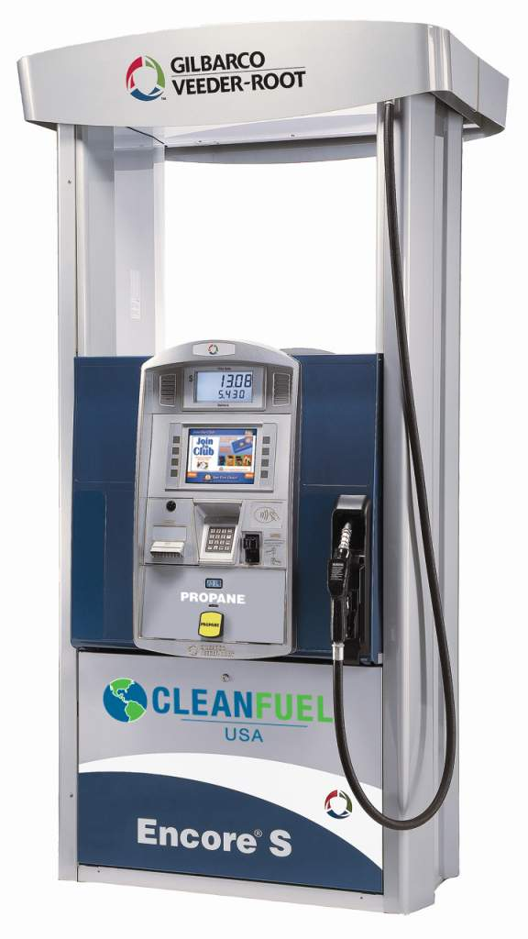
Electronic dispensers
- High frame, Commercial Style
- Key pad for secure self serve
- Attractive retail design
- Fully electronic dispenser
- Nozzle boot handle actuation
- Retail Displays:
Total Sale
Volume
Price per gallon

Slide 33

Notes:
33

